Slide 1
Automations in cartographic generalization
1. lesson
Introduction to generalization

Slide 2
Information
Lecturer: Zsuzsanna Ungvári
ELTE Department of Cartography and Geoinformatics
Northern Building 7.77
ungvarizs@map.elte.hu
Consulting hours: Tuesday 12 am-2 pm

Slide 3
What we are going to learn…
What is cartographic generalization?
When to generalize (with automations)?
How to generalize (with automations)?
Raster and vector data generalization.
Generalization in practice: QGIS, ArcGIS?
Basic algorithms programming. Python? GDAL?
Generalization on thematic maps.
Automations in geoinformatics

Slide 4
Requirements to complete successfully this course ☺
Regularly visit the classes
Doing the short homeworks
Student project: Map making with automatic generalization+documentation or point data generalization visualization and generalization Java.
And no exam ☺

Slide 5
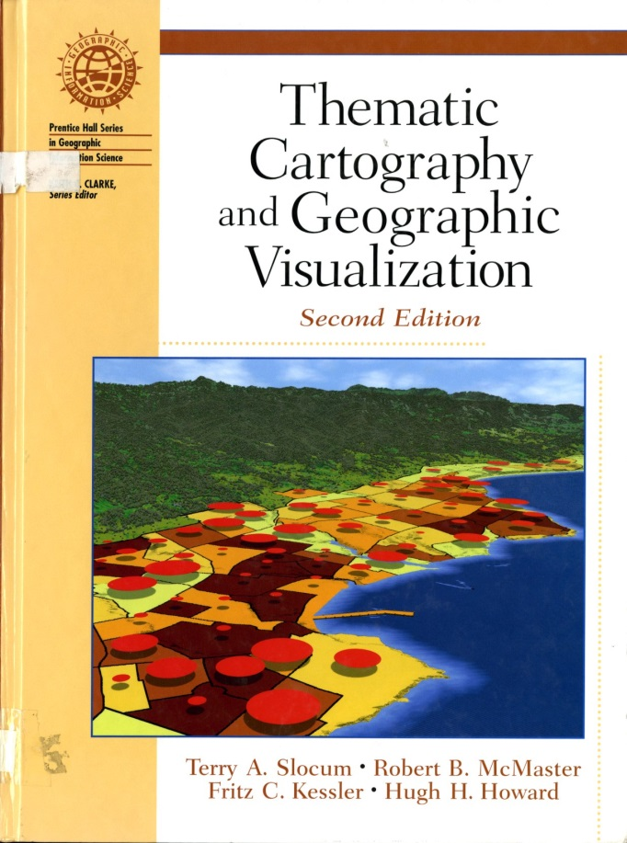
Recommended literature I.
Slocum, McMaster, Kessler, Howard: Thematic Cartography and Geographic Visualization.

Slide 6
Scale
The degree of reduction or enlargement
Geographic scale: Here the scale is equivalent to the extent of the area.
Large scale means a larger area for example a region, state, county. The small scale means a city, or even smaller entities.
Cartographic scale: based on mathematical principle, this is the representative fraction. It expresses as a ratio of map units to earth units (with the map units standardized to 1).
1:25 000 one map unit (centimeter) is equivalent to 25 000 /(centimeter)=250 meter/ unit on the Earth surface.

Slide 7
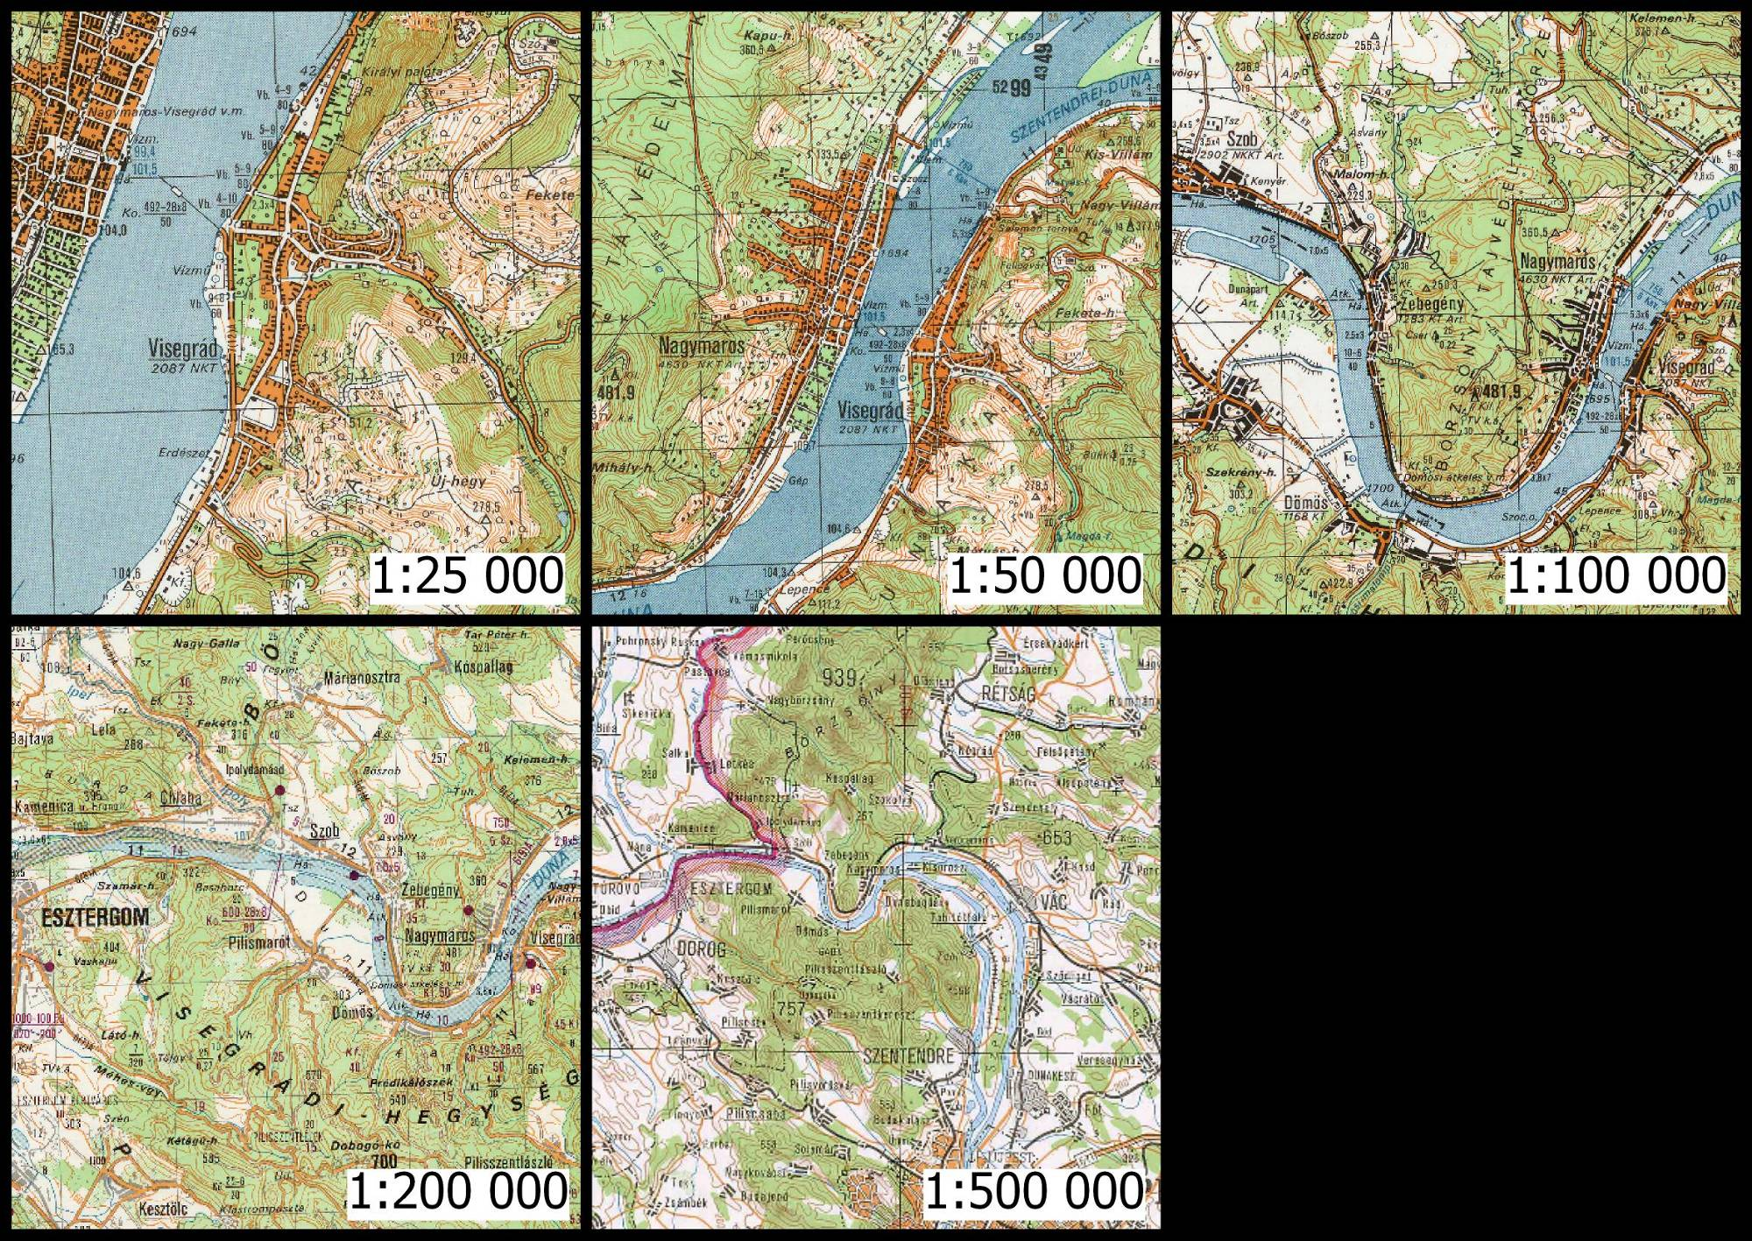
Topographic map series (Gauss-Krüger maps)
Source of figures: FARAGÓ IMRE: TÉRKÉPSZERKESZTÉS-TERVEZÉS (4)

Slide 8
Scales
Cartographic scale:
Large scales: <1:10 000
Medium scales: 1:10 000-200 0000
Small scales >1:200 000

Slide 9
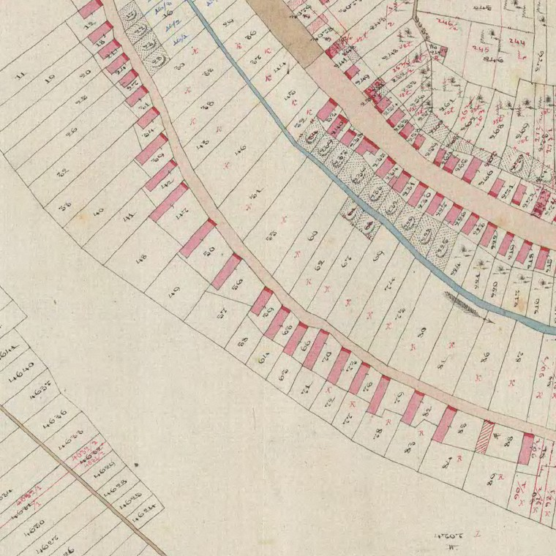
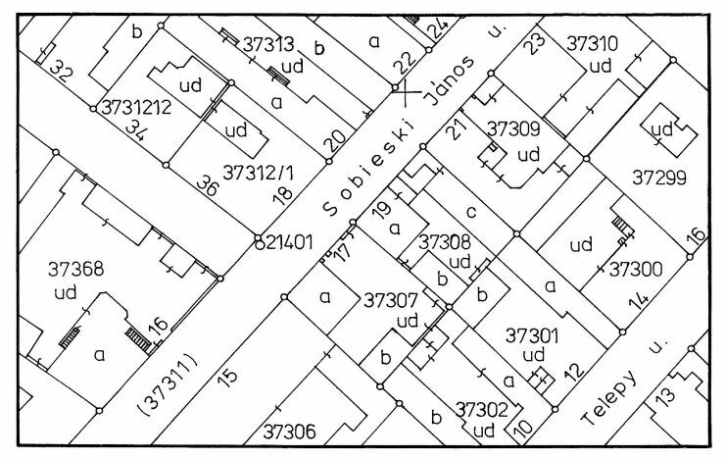
Large scale: cadastral maps

Slide 10
Large scale: topographic maps 1:10 000

Slide 11
Large scale: orienteering maps

Slide 12
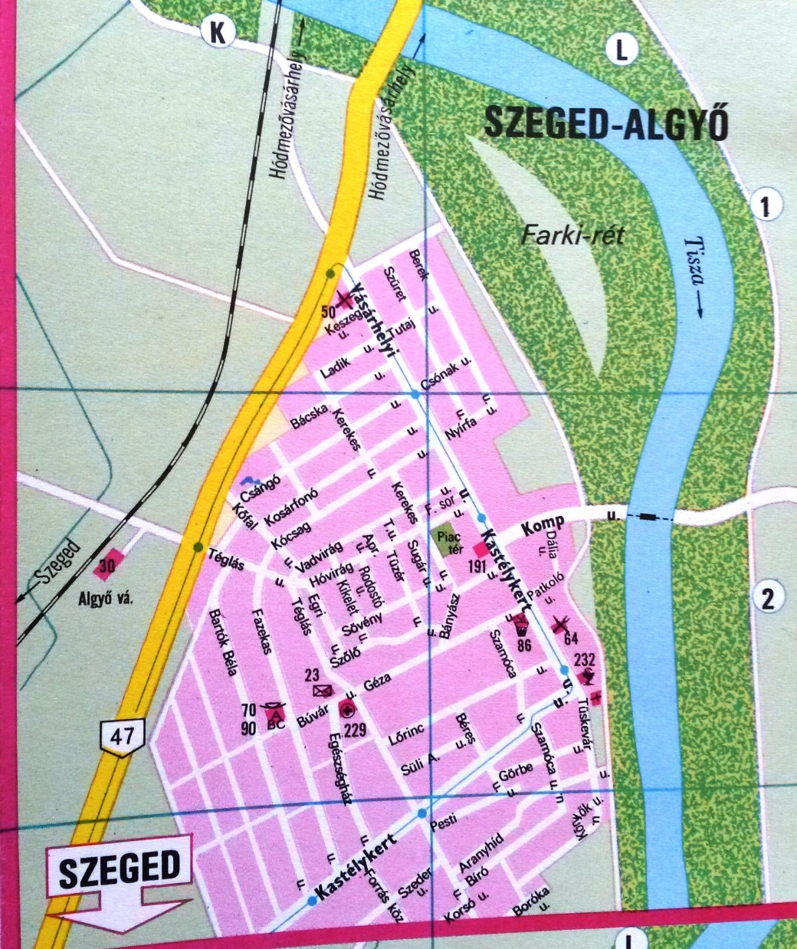
Medium scale: city maps

Slide 13
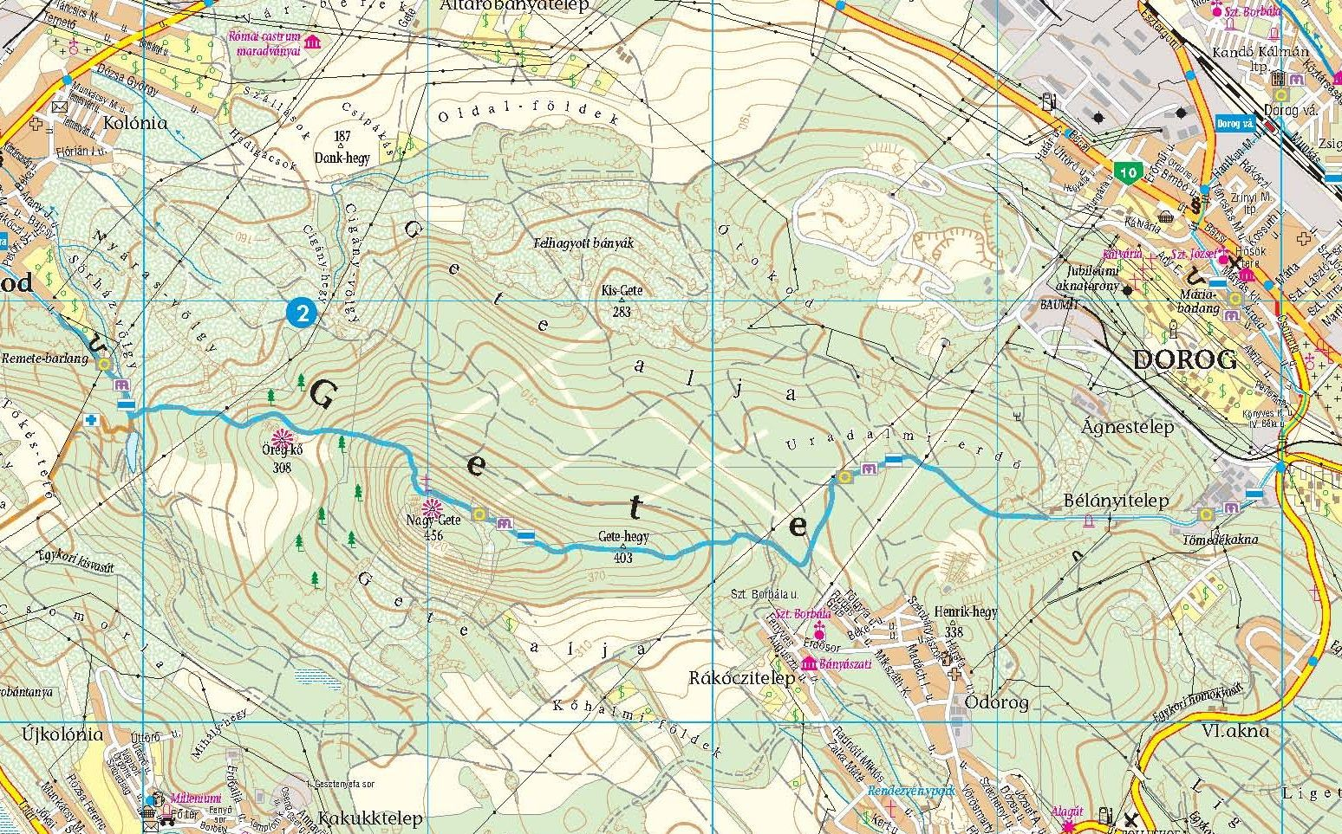
Medium scale: tourist maps

Slide 14
Small scale: geographic maps

Slide 15
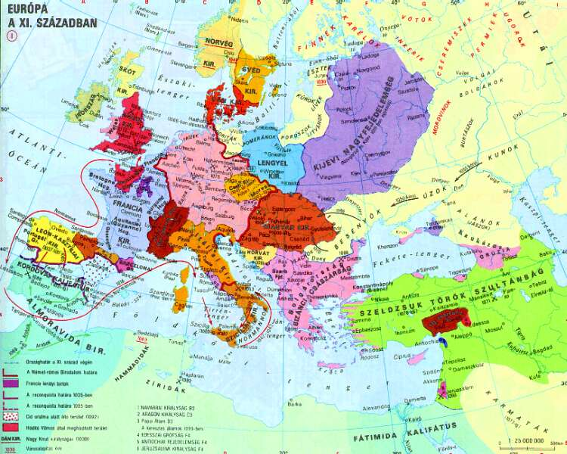
Small scale: historical maps

Slide 16
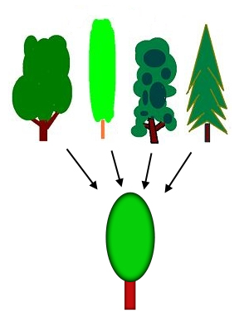
The map’s capacity and generalization
The maximal information content, what a map contains, it is called map’s capacity. This capacity is limited: the reality cannot be depicted as a whole. The cartographers have to select the characteristic information.
“Generalization is the process of reducing the information content of maps due to the scale change, map purpose, intended audience, and/or technical constraints.”
Filtering of information from noises
Notes:
Constraint=kényszer
Filtering!

Slide 17
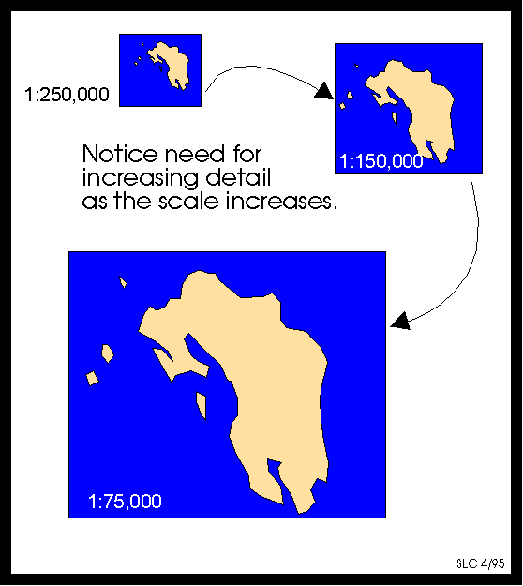
Scaling is not generalization!

Slide 18
Generalization

Slide 19
Topographic map series (Gauss-Krüger maps)
Source of figures: FARAGÓ IMRE: TÉRKÉPSZERKESZTÉS-TERVEZÉS (4)

Slide 20
Data resolution, Multi-scale DB
Data resolution is related to the scale, which indicates the granularity of the data that used in mapping.
Multi-scale databases/Multi-resolution datasets:
Every, smaller scale maps generate from the master database.
National Mapping Agencies!
Notes:
Optimal case: the data distribution is quite uniform.
National Mapping Agencies

Slide 21
Brief history of generalization

Slide 22
Brief history: Eckert, Wright
Max Eckert, Kartenwissenschaft (1921): Cartography is an academic science.
„In generalizing lies the difficulty of scientific map making, for it no longer allows the cartographer to rely merely on objective facts but requires him to interpret them subjectively.”
John K. Wright, 1942: He identified two major components of the generalization process: simplification (reducing information), and amplification (enhancement the sparse information).

Slide 23
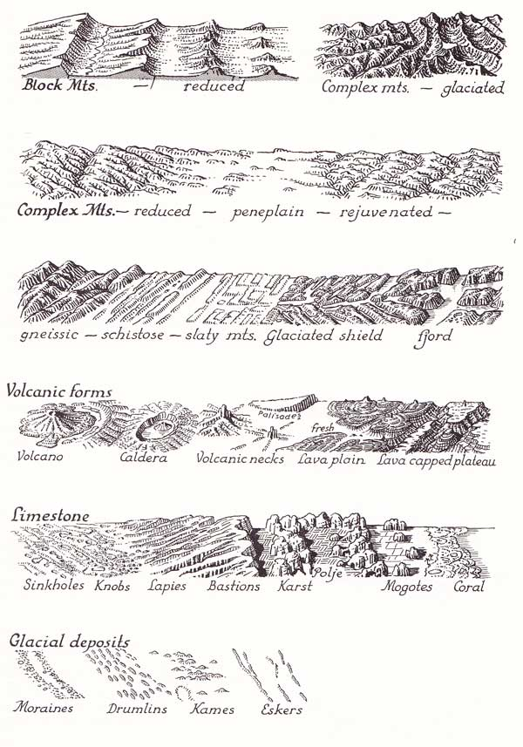
Brief history: Raisz, Robinson
Erwin Raisz, 1962:
generalization=combination, omission, simplification (delete or reduce the unnecessary information)
Arthur Robinson, 1978:
generalization=selection
(preprocessing);
simplification + classification +
Symbolization (graphics encoding)
Notes:
Omission=elhagyás
Symbolization>graphic encoding
Simplification>delete/reduce the unnecessary information

Slide 24
Kilpeläinen 1997
Tiina Kilpeläinen
Digital Landscape Model (DLM): large scale model/master database of the Earth
→cannot visualize
Digital Cartographic Model (DCM): derived from DLM through generalization and graphic symbolization.

Slide 25
Brassel & Weibel 1988
Their model based on terrain generalization
(different terrain types, scales, map purposes)→ inplement to this strategies in an automated environment.
Structure recognition
Process recognition
Process modeling
Process execution
Data display and evaluation of result
Notes:
Process recognition: generalization operators parameters> if we know them we can transform the source data.
Process modeling compile the rules and procedures Algorithmic

Slide 26
Robert McMaster, Stuart Shea 1992
„The generalization process supports a variety of tasks, including:
Digital data storage reduction
Scale manipulation
Statistical classification and symbolization
Why to generalize? Theoretical objective
When to generalize? Cartometric evaluation
How to generalize? Fundamental operations

Slide 27
Why to generalize?
REDUCING COMPLEXITY
Maintaining spatial accuracy, aesthetic quality, attribute accuracy, logical hierarchy, consistently applying the rules of generalization

Slide 28
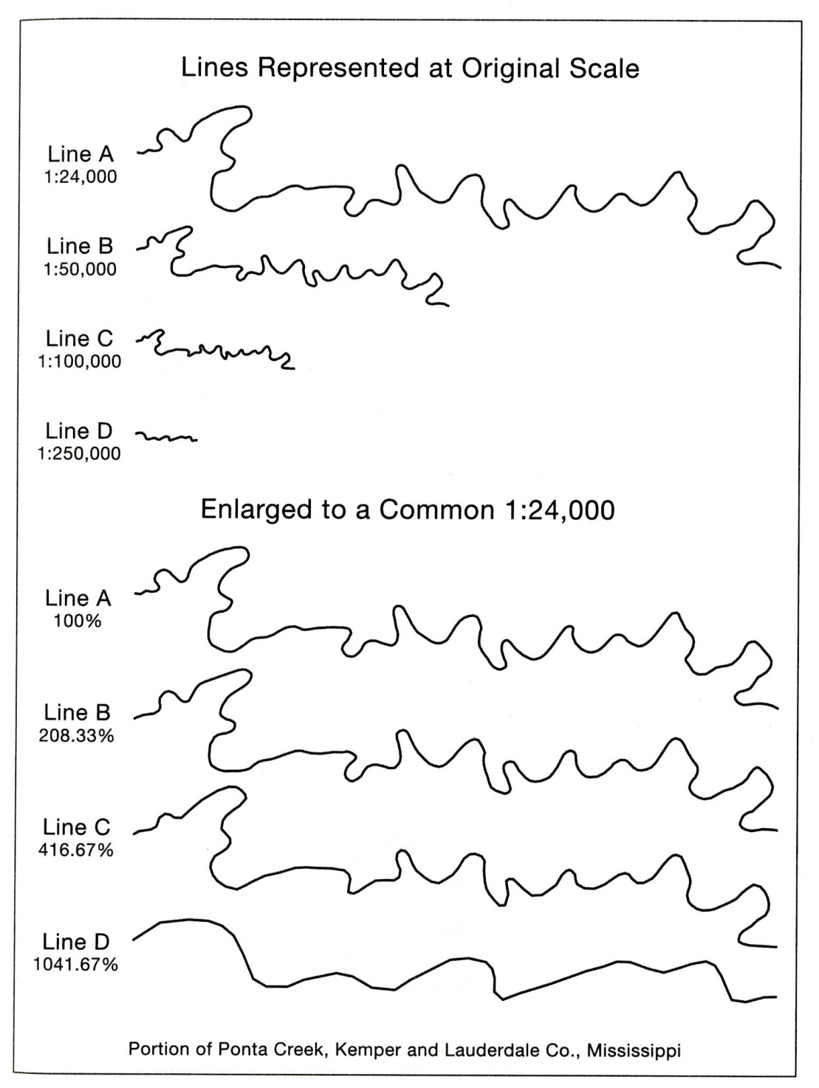

Slide 29
Generalization & scales
Example: relationship between cities and scales
→ Scale change less than 10x between the original map and the derived one. (Manual! Digital?)
Maintaining the spatial attribute’s accuracy of features. Example: simplification, displacement. → reducing this effects/measure the new „accuracy”

Slide 30
When to generalize?
Congestion (too many buildings)
Coalescence (objects touch each others /displacement/)
Conflict (eliminated bay, city does not lay on the coast)
Complication (one line is too smooth or too crenulated)
Inconsistency
Imperceptibility
Notes:
Complication: Barbara Buttenfield> solution: using different tolerance values at each part of the line.

Slide 31
Basic types of measures
Procedural measures:
Control the process of generalization
Selecting simplification algorithm
Modifying the tolerance value along the feature
Asses the set of polygons, which are considered
Feature undergo to the limit where the representation change
Compute the curvature the line segment
Quality assessment measures:
Overall quality of gen.

Slide 32
McMaster and Shea 1992, Classification of measures
Density measures: multifeature relationships, number of points, lines, area features per a unit area. (Blocks in a metropolitan area)
Distribution measures: overall spatial configuration (stream network distribution)
Length and sinusoity measures: total length, average number of coords, standard deviation per map unit. Angular change per map unit, angular change per angle, sum of positive and negative angles…
Shape measures: form of objects, features can be represented at the new scale.
Distance measures: shortest perpendicular distance/shortest eucledian dist., line buffer to line buffer; line to line
Gestalt measures: structural relationship between elements, (closure, continuation, proximity, similarity)

Slide 33
Types of generalization process
Simplification/smoothing
Displacement
Enlargement
Aggregation
Selection
Classification
Exaggeration

Slide 34
Fundamental operations 1.

Slide 35
Fundamental operations 2.

Slide 36
Deriving maps
Base maps are topographic maps or other databases in the most cases.
If the scale is smaller we have to reduce the information→ The correctness and completeness have to be limited.

Slide 37
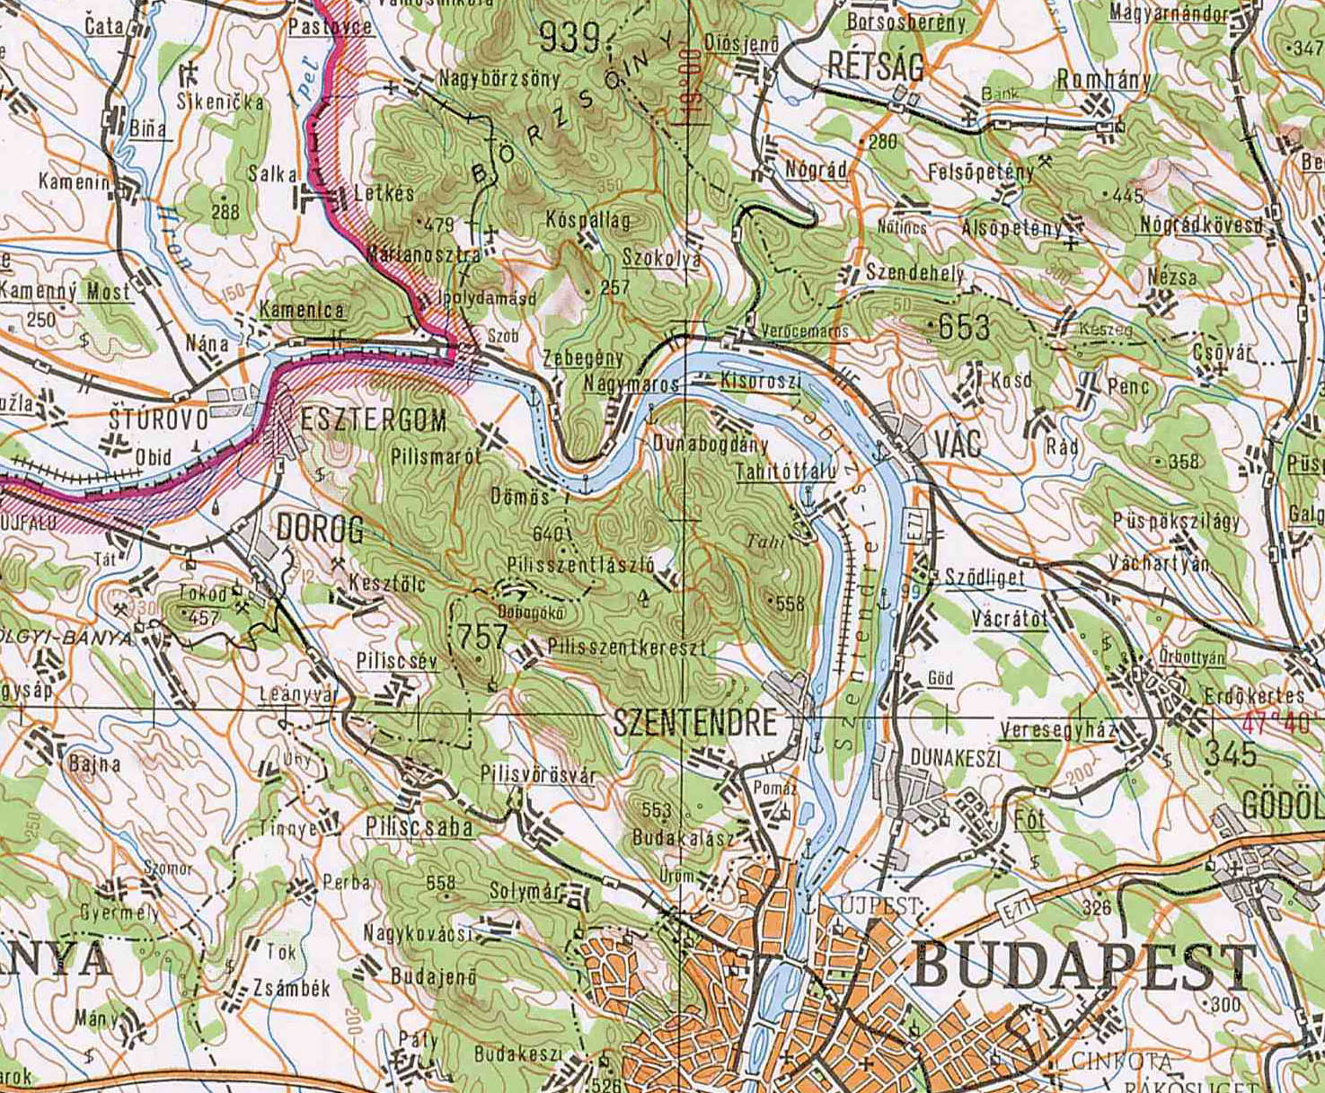
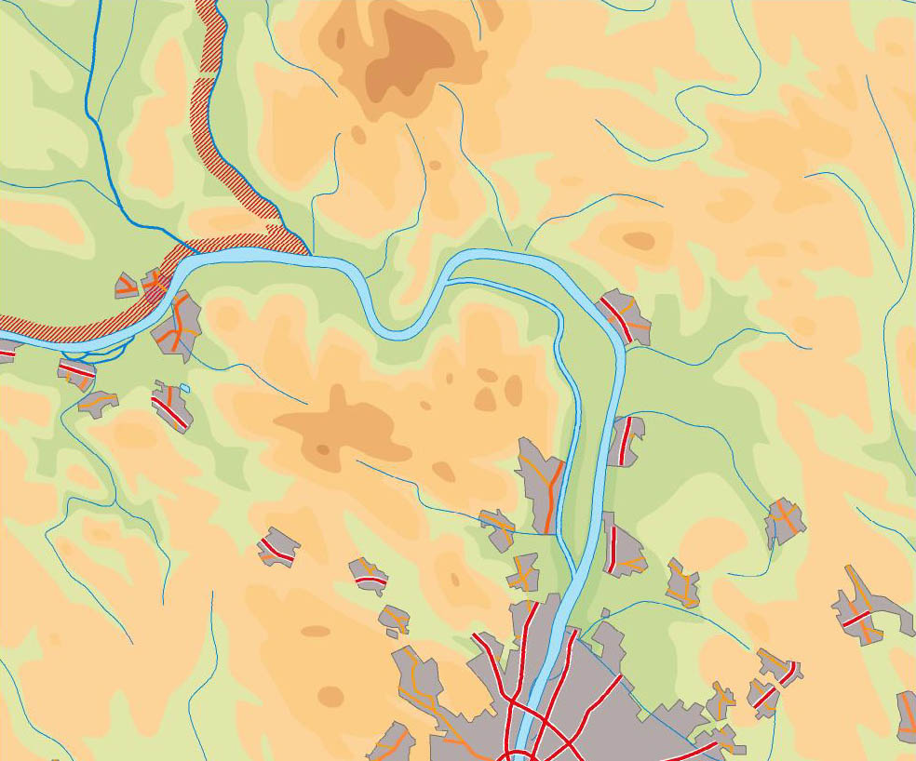
Simplification
Simplification of settlements at 1:500 000
Source of figures: FARAGÓ IMRE: TÉRKÉPSZERKESZTÉS-TERVEZÉS (4)
Notes:
Simplification of shape of lines. Deleting unnecessary coordinates. Keeping the geometry, similar to the real one, while eliminating the maximum number of points.

Slide 38
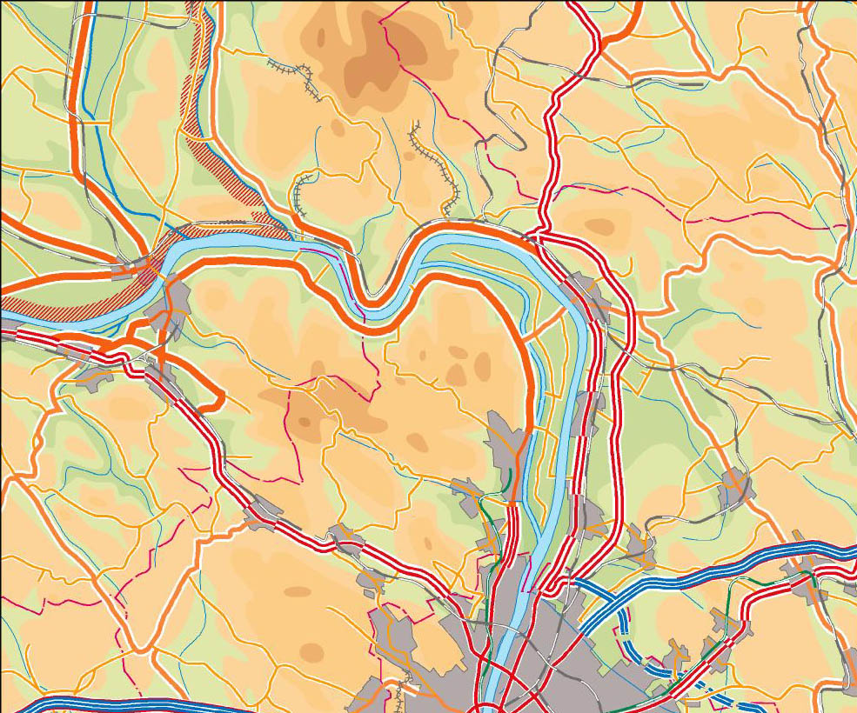
Exaggeration
The roads are wider than in reality
Source of figures: FARAGÓ IMRE: TÉRKÉPSZERKESZTÉS-TERVEZÉS (4)
Notes:
Exaggeration is often used operator to maintain the clarity of the map object at smaller scale. For example a bay inlet

Slide 39
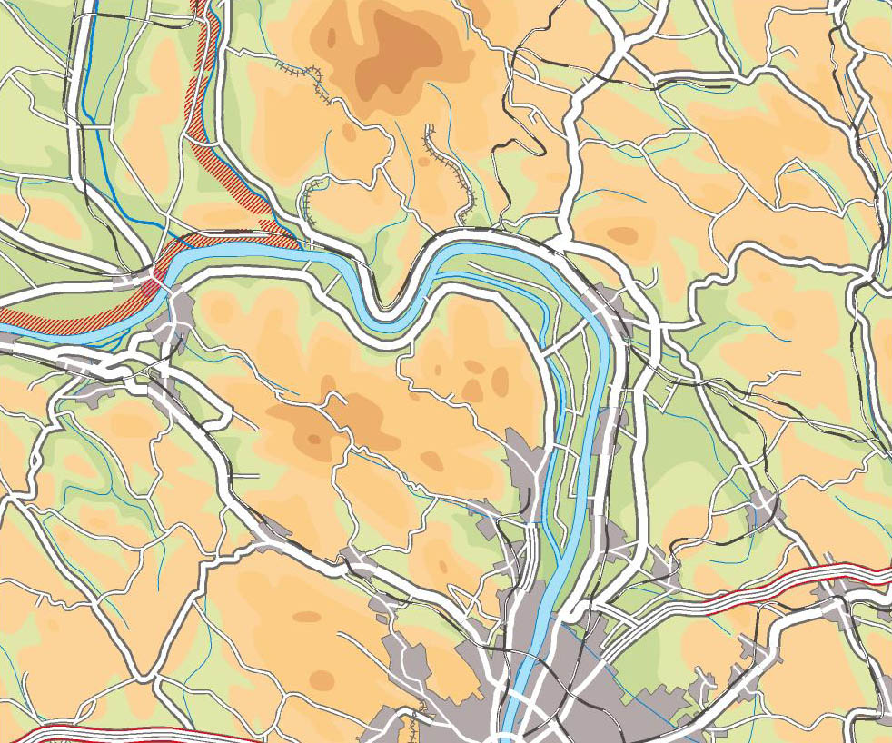
Displacement
Source of figures: FARAGÓ IMRE: TÉRKÉPSZERKESZTÉS-TERVEZÉS (4)
Notes:
The objects are too close to each other. In the case of figure the river is staying fixed, but the road and the railway are shifted.

Slide 40
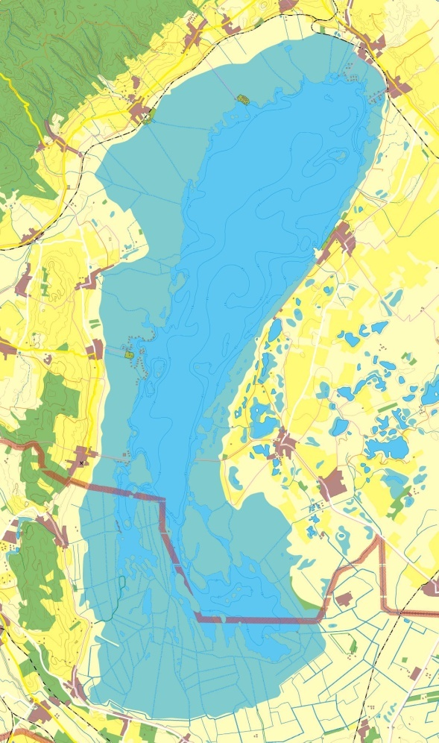
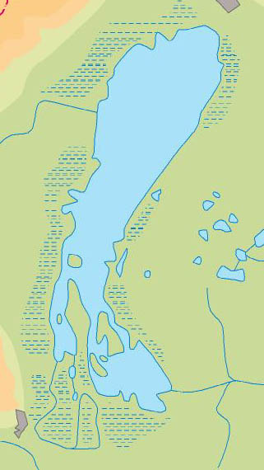
Amalgamation
The area covered by reed are amalgamated with moors or lands.
Do not cluster islands or peninsulas
1: 100 000 1:500 000
Source of figures: FARAGÓ IMRE: TÉRKÉPSZERKESZTÉS-TERVEZÉS (4)
Notes:
Amalgamation is the process of fusing nearby polygons. The attributes are same or similar.

Slide 41
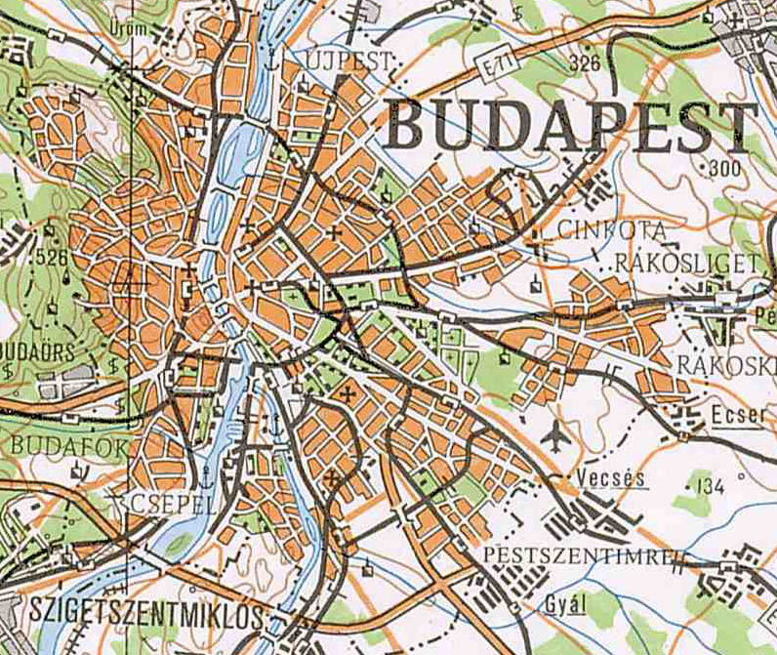
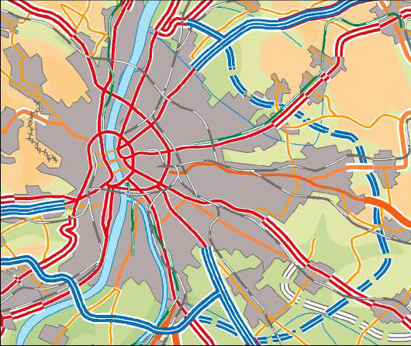
Selection
Selection of main roads inside of city
Source of figures: FARAGÓ IMRE: TÉRKÉPSZERKESZTÉS-TERVEZÉS (4)

Slide 42
Collapse
Notes:
Changing the simbolization of object.The original object is too small to represent its geometry.

Slide 43
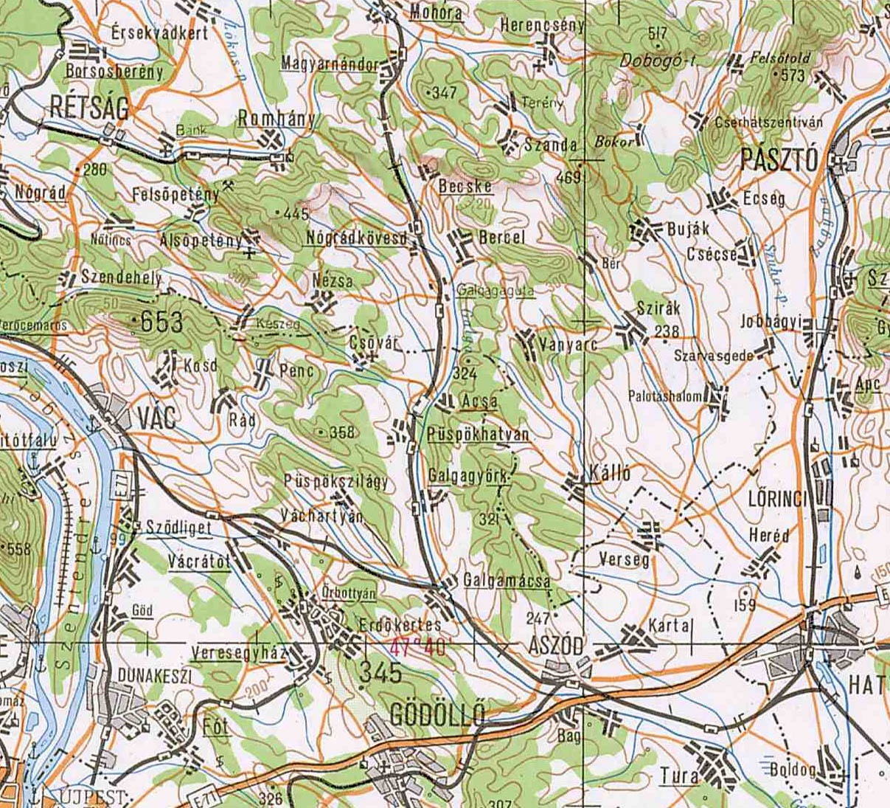
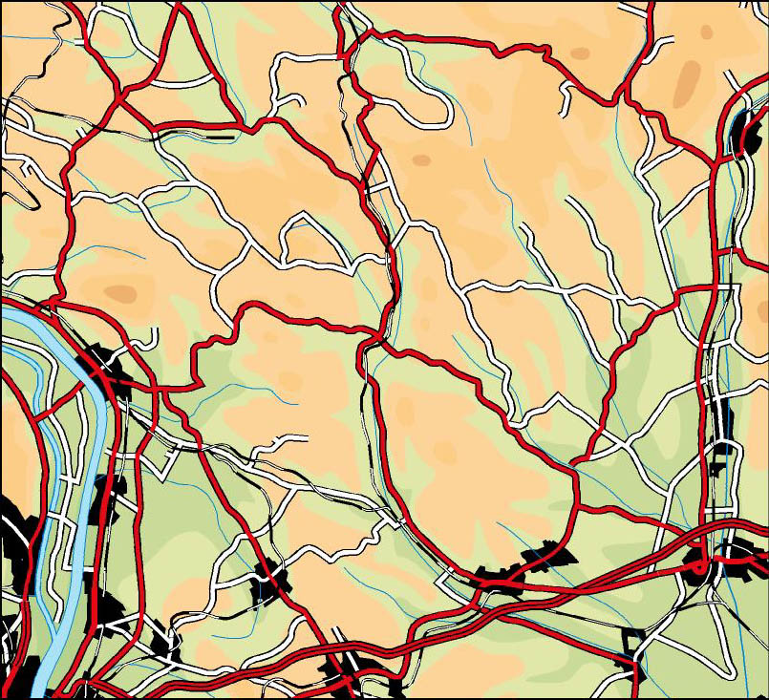
Enhancement
Source of figures: FARAGÓ IMRE: TÉRKÉPSZERKESZTÉS-TERVEZÉS (4)
Notes:
Emphasize the importance of an object. For instance a bridge with symbol.

Slide 44
Smoothing
Notes:
Smoothing of too angled or peaked parts of an object.

