Slide 1
Automations in cartographic generalization
2. lesson
Generalization of features classes, line simplification

Slide 2
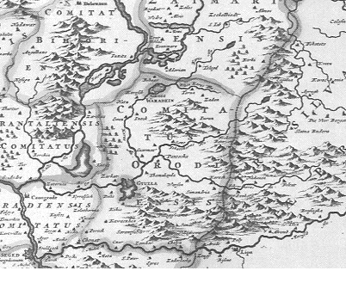
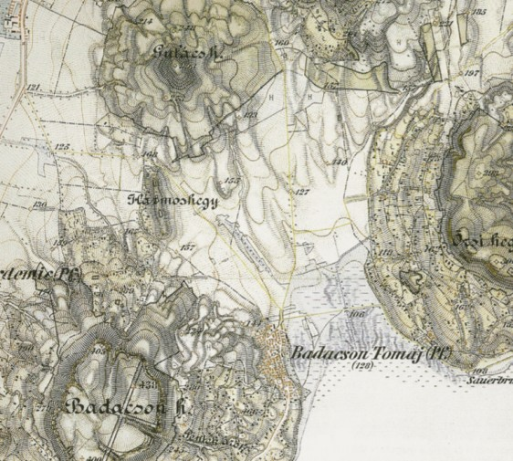
Representing relief by older methods
Notes:
Oldalnézetes domborzatábrázolás= hill profiles
Hachure map = csíkozás They show orientation of slope, and by their thickness and overall density they provide a general sense of steepness. Hachure representation of relief was standardized by the Austrian topographer Johann Georg Lehmann in 1799.

Slide 3
Representing terrain: Contour lines
Notes:
Eséstüske, kiegészítő jelek
Isoline, no crossing, elevation value, contour interval

Slide 4
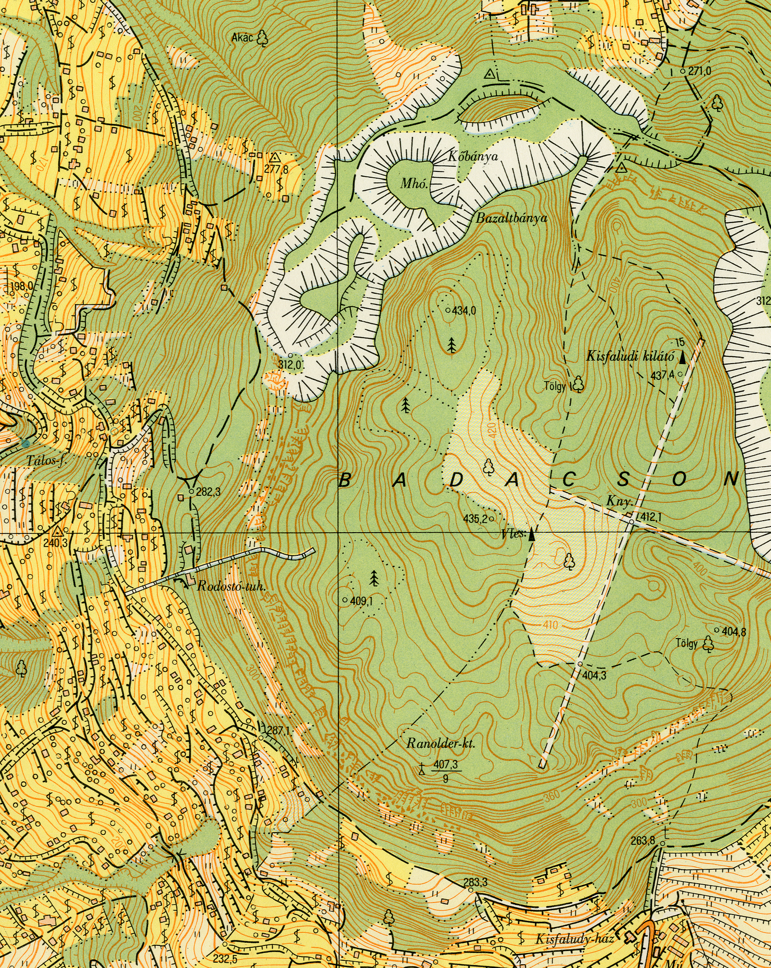

Slide 5
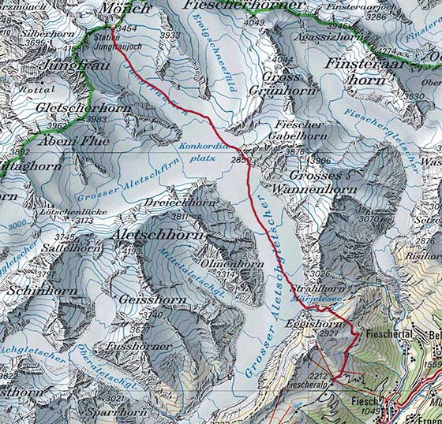
Topomaps in Switzerland
Notes:
Sziklák, gleccser

Slide 6
Contour lines
Polylines
Horizontal and vertical gen.
Horizontal→ Line generalization algorithms
They are curves! Smoothing!
Vertical gen.: Selection of each elevation

Slide 7
Creating contours
Old data sources: stereophotogrammetry
Current sources: digital elevation models (DEM), laser scanning survey, lidar surveys… (depends on scale)
Creating contour lines in a geoinformatics software (ArcGIS and QGIS)
Challange: the GIS software only make the lines and no other symbols

Slide 8
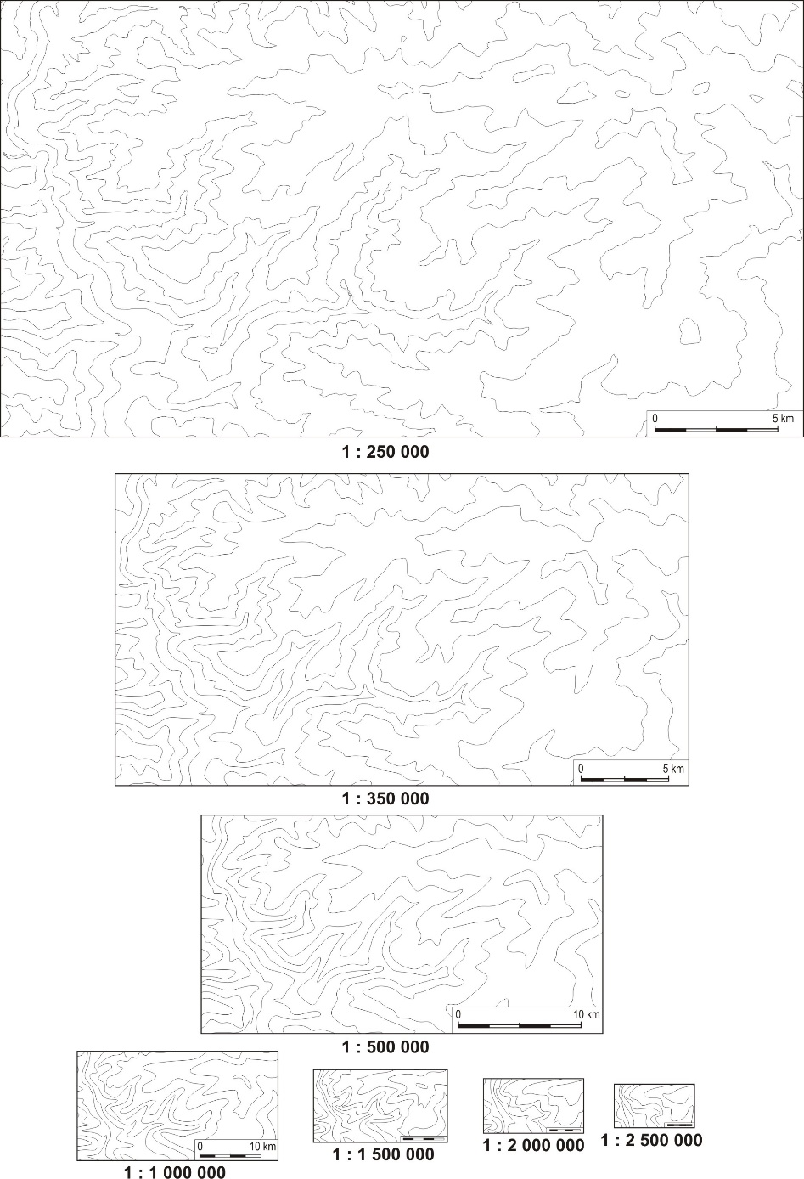
Horizontal generalization
Reducing the number
of polyline nodes,
while keeping geometry.
Usage of line simplification and smoothing algorithms.

Slide 9
Vertical generalization: Carpathian basin and the Iberian abyssal plain

Slide 10
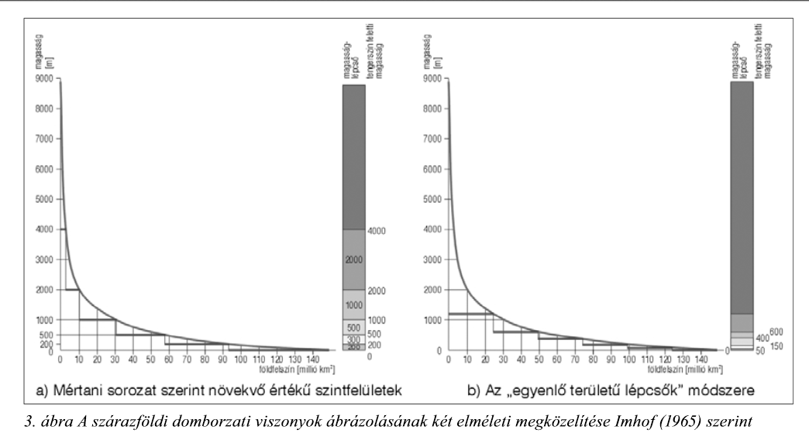
Imhof (1965): a) Increase of elevations by geometric progression, b) The method of „equal area stairsteps ”

Slide 11
The frequency of elevation (height and depths) values of the Earth in percentage of the total surface
Earth surface (%)
Landmass
Oceans
Earth surface (million km²)

Slide 12
Bathymetric lines
The representation of optimal number of bathymetric lines is important.
DEM, which contains bathymetry: ETOPO1

Slide 13
Example: the number of contour intervals on maps of various scales
Scale-range | Ocean | Continent (Landmass)
1:25million > | 16 | 7
1: 10-25 m | 28 | 12
1:7,5-10m | 31 | 13
1:5-7,5m | 45 | 19
1:2,5-5m | 68 | 29
1:1-2,5m | 111 | 47

Slide 14
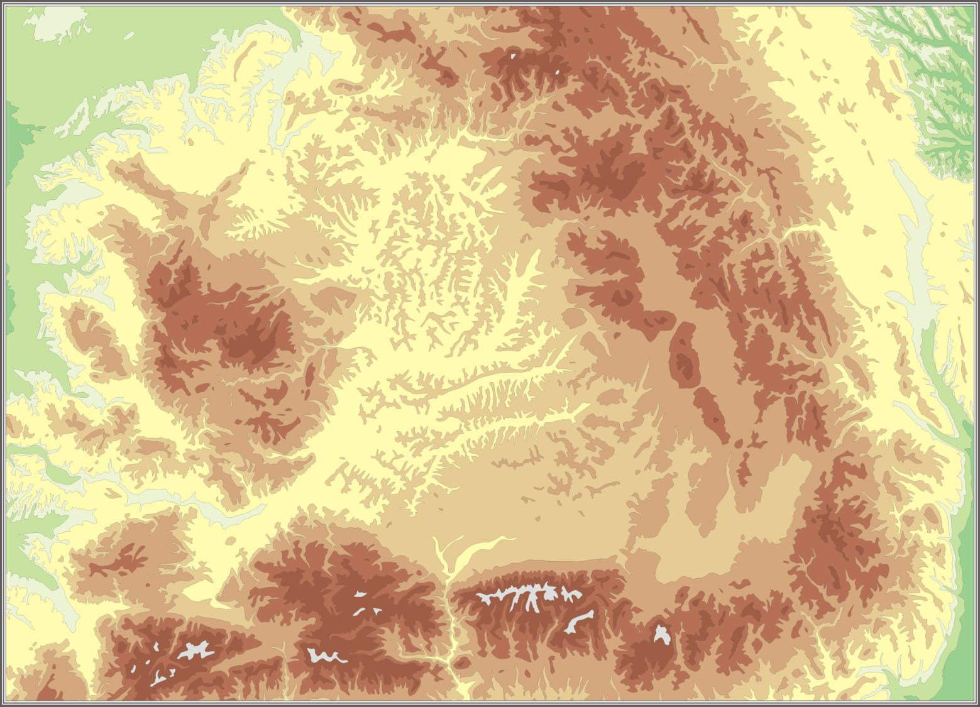
Hypsometry and bathymetry

Slide 15
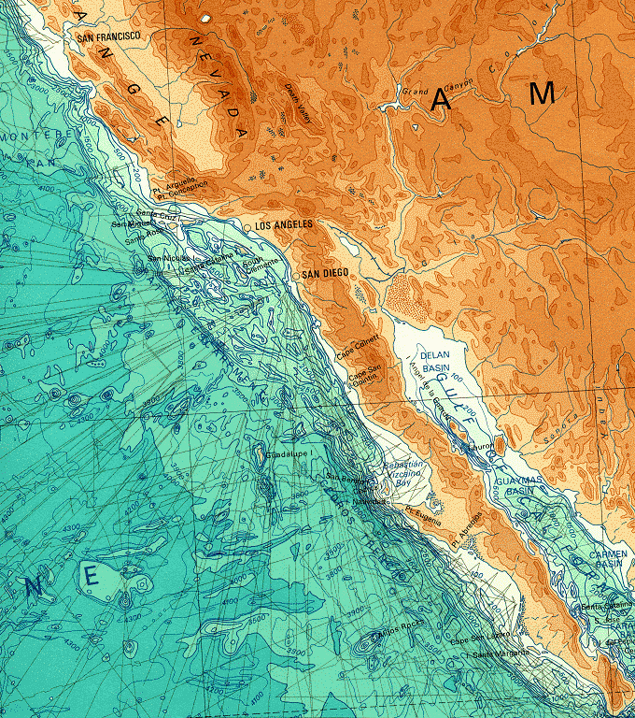
Hipsometric and bathymetric tint
For terrain representation only in small scale
There are two types in digital cartography: Continous and discrete colouring

Slide 16
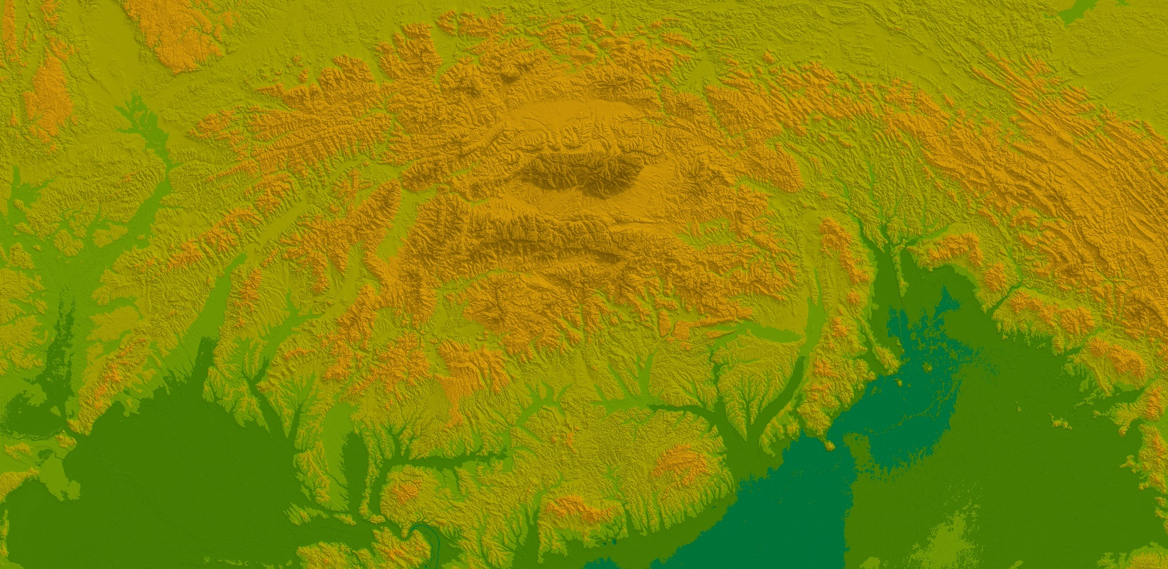

Slide 17
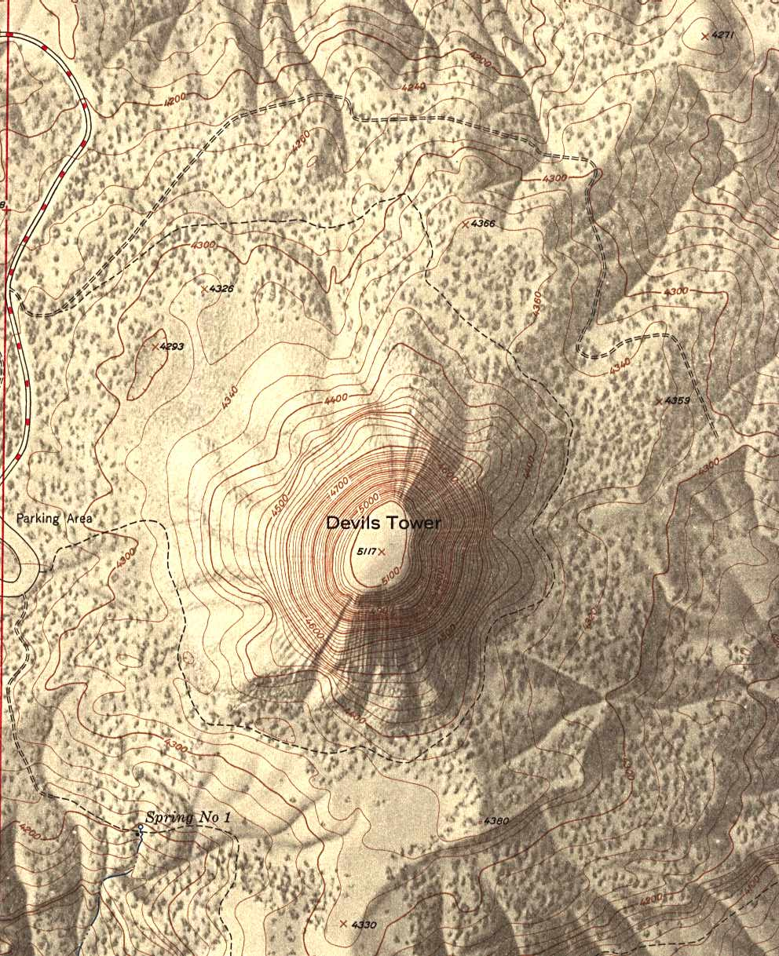
Hill shading

Slide 18
Water network - rivers
Polyline generalization and smoothing
Selection (refinement):
Delineation!
Database driven gen: attributes contains the importance of each rivers. (Average discharge/the volume rate of water flow/
Together with contours! The contours should follow the water system and not reversed!

Slide 19
Water network –lakes or rivers represented as polygons
Polygon simplification→ Polyline
Smoothing
When change the representation of rivers as polygon to polyline? (Collapse)
Amalgamation
Notes:
http://www.colorado.edu/geography/babs/webpage/publications/NACIS%202012_Buttenfield_et_al_2012_Braids.pdf

Slide 20
Simplification
Point remove algorithm (ArcGIS) with different tolerance values (original, 100 m, 200 m, 500 m)

Slide 21
Simplification with lost topology
Important to preserve topology

Slide 22
Smoothing after simplification
Pay attention for checking geometry

Slide 24
Delineation

Slide 25
Coastlines
Convert the polygons to polylines
„No topology”
„0 meter” special case of contour lines
Example: Drazen Tutic: Area preserving method: http://www.kartografija.hr/gshhs/

Slide 26
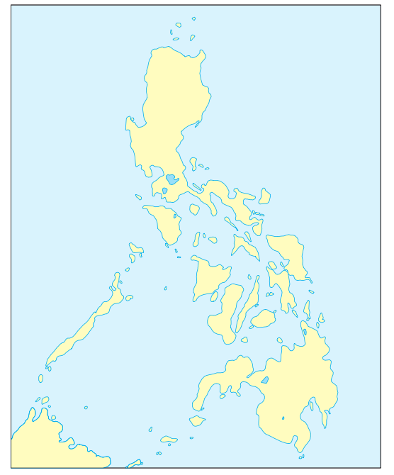
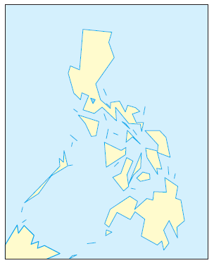
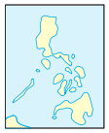
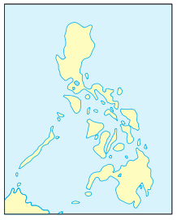
Preserving areas
1:100m
1:50m 1:20m

Slide 27
Coastlines

Slide 28
Mistakes in automations intersections or closed lines

Slide 29
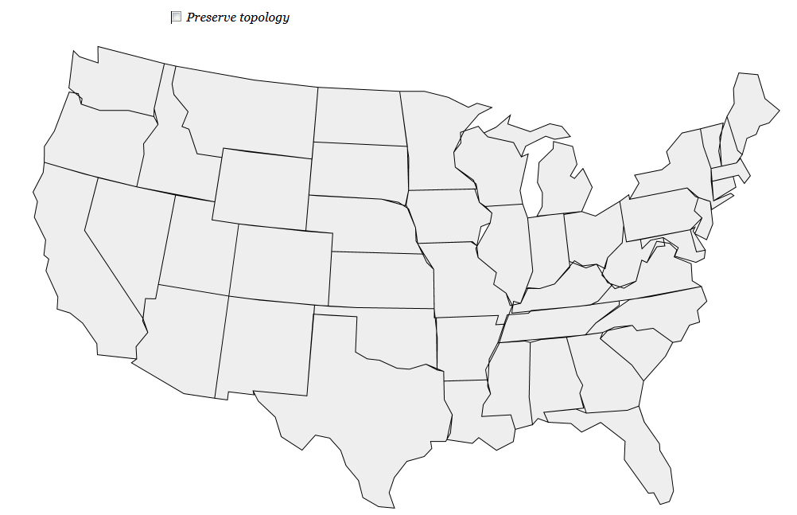
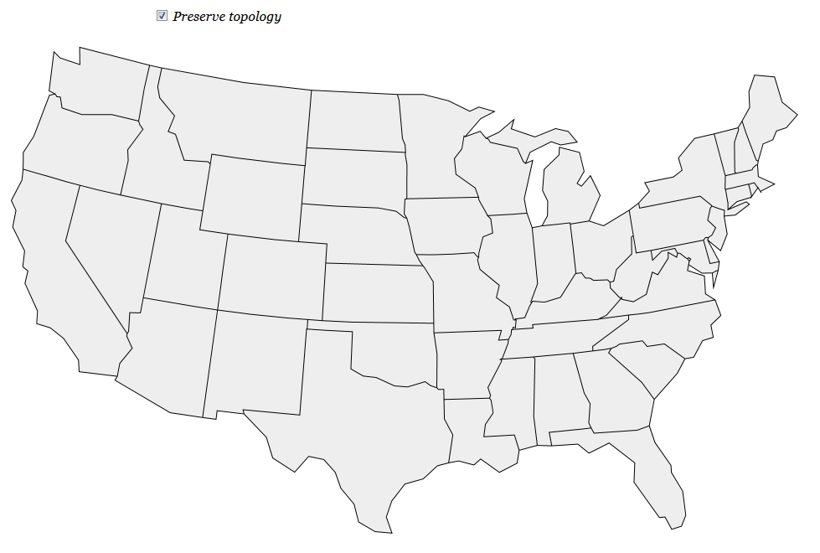
Borders
Consider to preserve the topology→ Critical points

Slide 30
Borders
At administration borders, we can not leave each units.
A nice examples available here: http://bost.ocks.org/mike/simplify/
https://www.jasondavies.com/simplify/

Slide 31
Roads
Polyline simplification
Selection by categories (importance)
Selection by average traffic
…
If you no have categories an example is here:
http://www.cartogis.org/docs/proceedings/2012/Brewer_etal_AutoCarto2012.pdf

Slide 32
Railways
Example for categories
International or national traffic
Rail-gauge (Distance between rails)
Used/not used (closed)
Normal railways, Suburban railway, tram lines
Smoothing!

Slide 33
Buildings
Selection by grouping → Amalgamation
Enhancement of important building
Displacement (to each others, to roads)
Collapse-> Change the symbol

Slide 34
Land cover (poygons)
Polygon→ Polyline simplification
Topology preserving
Amalgamation
European free land cover dataset: CORINE 2000 and 2006.

Slide 35
Land cover

Slide 36
Fundamental operations of generalization → How to generalize?
Types of generalization operations for vector and raster processig are fundamentally different.
Vector-based: XY based, more complex searching strategies.
Raster-based: proximity relationships is the basis.

Slide 37
Vector-based operations - Simplification
The most commonly used operator
Selecting critical/significant points
Deleting unnecessary coordinates
Keeping the geometry while eliminating the maximum number of coordinates
Classification
Examples: http://www.codeproject.com/Articles/114797/Polyline-Simplification#headingNP

Slide 38
Classification

Slide 39
Nth point

Slide 40
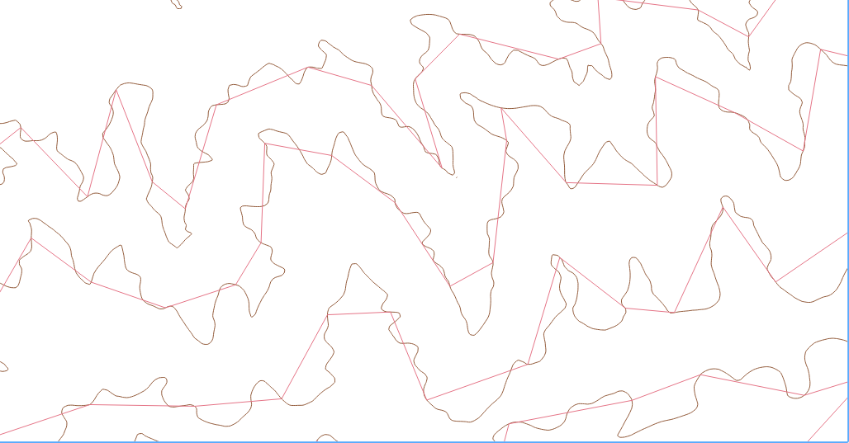
Nth point

Slide 41
Code
def nthPoint(points,epsilon): #points[x,y], epsilon #Tolerance value
firstPoint=points[0]
lastPoint=points[len(points)-1]
rs=[] #New point array
if len(points)<4:
return points
else:
rs.append(firstPoint)
for i in range(0,len(points)-1,epsilon):
rs.append(points[i])
rs.append(lastPoint)
return rs

Slide 42
Radial distance

Slide 43
Radial distance
The first and last points are always kept.
Select the first point as the key point.
Select the point after the key point as the test point.
If the distance between the key point and the test point is less than the tolerance eliminate the test point, and restart at step 3.
If the distance between the key point and the test point is greater than the tolerance set the new key point to the current test point and restart at step 3.
Continue this algorithm until the second from last point is the key point.

Slide 44
Perpendicular distance

Slide 45
Code
def findperpendicularDistance(p1,p2,p3): #Calculate the perpendicular distance
if p3[0]==p1[0]:
slope=(p3[1]-p1[1])/0.000001 #Cannot divide by 0
else:
slope=(p3[1]-p1[1])/(p3[0]-p1[0])
intercept = p1[1] - (slope * p1[0])
result = abs(slope * p2[0] - p2[1] + intercept) / math.sqrt((slope**2)+1)
return result

Slide 46
Code 2.
def perpendicularDistance(points,epsilon):
rs=[]
key=0
firstPoint=points[0]
lastPoint=points[len(points)-1]
if len(points)<4:
return points
else:
for i in range(1,len(points)-1):
D=findPerpendicularDistance(points[i],points[i-1,points[i+1])
If D<epsilon:
del points[i]

Slide 47
Jenk’s
Angular change and distances between neighboring points (in QGIS)

Slide 48
Jenk’s

Slide 49
Lang: 2 parameters (Look ahead, tolerance)

Slide 50
Lang

Slide 51
Lang
Select the first point as the key point.
Select the last point as the end point.
If there are no points between the key point and end point.
And if the end point is not the last point.
Make the end point the new key point.
Make the last point the new end point.
Restart step 3 using the new end point and key points.
And if the end point is the last point.
Exit the algorithm
If there are points between the key point and the end point.
Continue to step 5.

Slide 52
Lang
Create a line between the key point and the end point.
Find the point between the key point and the end point with the largest perpendicular distance from this line.
If that distance is greater than some tolerance.
Decrement to the end point.
Restart at step 3 using the new end point.
If that distance is less than, or equal to, the tolerance.
Eliminate all points between the key point and the end point.
Make the end point the new key point.
Make the last point the new end point.
Restart at step 3.

Slide 53
Reumann-Witkam

Slide 54
Reumann-Witkam

Slide 55
Algorithm
Select the first point as the key point.
If there is less than 3 points after the key point, end the algorithm.
Create a line using the key point and the point following the key point.
Select the point two points after they key point as the first test point.
If the perpendicular distance from the test point to the line is less than a tolerance.
Increment the test point.
Repeat this step using the new test point.
If the perpendicular distance from the test point to the line is greater than a tolerance.
Remove all points between the key point and the point before the current test point. This keeps the key point and the point with the furthest perpendicular distance within tolerance.
If there are no points between them (because the first test point was larger than the tolerance), no points are eliminated.
Increment the key point and restart from step 2.

Slide 56
Douglas-Peucker (in ArcGIS: Point remove)

Slide 57
Douglas-Peucker

Slide 58
Douglas-Peucker

Slide 59
Code
def findperpendicularDistance(p,p1,p2):
if p1[0]==p2[0]:
result=abs(p[0]-p1[0])
else:
slope=(p2[1] - p1[1]) / (p2[0] - p1[0])
intercept = p1[1] - (slope * p1[0])
result = abs(slope * p[0] - p[1] + intercept) / math.sqrt((slope**2)+1)
return result
def douglasPeucker(points,epsilon):
firstPoint=points[0]
lastPoint=points[len(points)-1]
if len(points)<3:
return points

Slide 60
Code 2.
index=-1
dist=0
for i in range(1,len(points)-1):
cDist=findperpendicularDistance(points[i],firstPoint, lastPoint)
if cDist>dist:
dist=cDist
index=i
if dist>epsilon:
l1=points[0:index+1]
l2=points[index:]
r1=douglasPeucker(l1,epsilon)
r2=douglasPeucker(l2,epsilon)
rs=r1[0:len(r1)-1]+r2
else:
return [firstPoint,lastPoint]
return rs

Slide 61
Using Douglas-Peucker algorithm without smoothing for contour lines

Slide 62
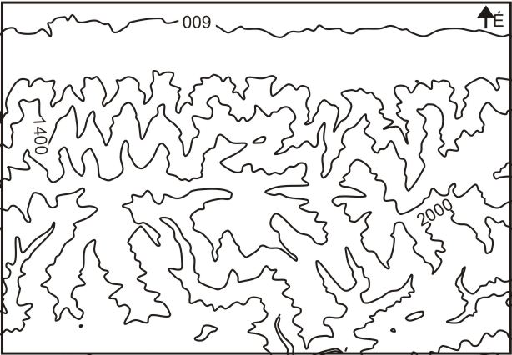
Douglas-Peucker + Smoothing with Bezier curves

Slide 63
Visvalingam-Whyatt
Based on small triangles
https://hydra.hull.ac.uk/assets/hull:8338/content
http://bost.ocks.org/mike/simplify/
Excluding The first and last points, calculate the effective area of each point.
Remove the point with the least effective area and place it into a stack.
Repeat steps 1 and 2 until all except the first and last points have been placed into the stack.
Starting at the top of the stack (the point with the most effective area) remove points and place them back into their proper position in the original point list
Repeat step 4 until the list is of the desired size.

Slide 64
Wang in ArcGIS (Bend simplify)
http://www.tandfonline.com/doi/pdf/10.1559/152304098782441750

Slide 65
JavaScript implementation
https://gist.github.com/adammiller/826148
DP algorithm implementation in JavaScript

Slide 66
Douglas-Peucker algorithm in software
Quantum GIS + Generalizer module
http://www.qgis.com
ArcGIS Cartography Toolbox
PostGIS, SpatiaLite->GEOS Library (DP)
GRASS V. Generalize
Python GDAL (OGR) module
FME desktop:

Slide 67
ArcGIS 10.1 Cartography Toolbox
http://resources.arcgis.com/en/help/main/10.1/index.html#//00700000002r000000
Notes:
http://web.cs.sunyit.edu/~poissad/projects/Curve/about_algorithms/lang.php

Slide 68
SRTM

Slide 69
Polyline/polygon simplification in practice: Example: Contour lines
Take an Digital Elevation Model (DEM)(SRTM: http://srtm.csi.cgiar.org/)
Generate contours from DEM
Example: The generated contour lines from SRTM
(90 m spatial resolution) are suitable to make map with contour lines at scale 1:150k-200k.
If we make a map at scale 1:1m, we have to generalize them. Using Douglas-Peucker simplification method the lines will be broken. These broken line were replaced by Berzier curves.
Finally, hypsometry was added to the map.

Slide 70
SRTM

Slide 71
SRTM

Slide 72
SRTM

Slide 73
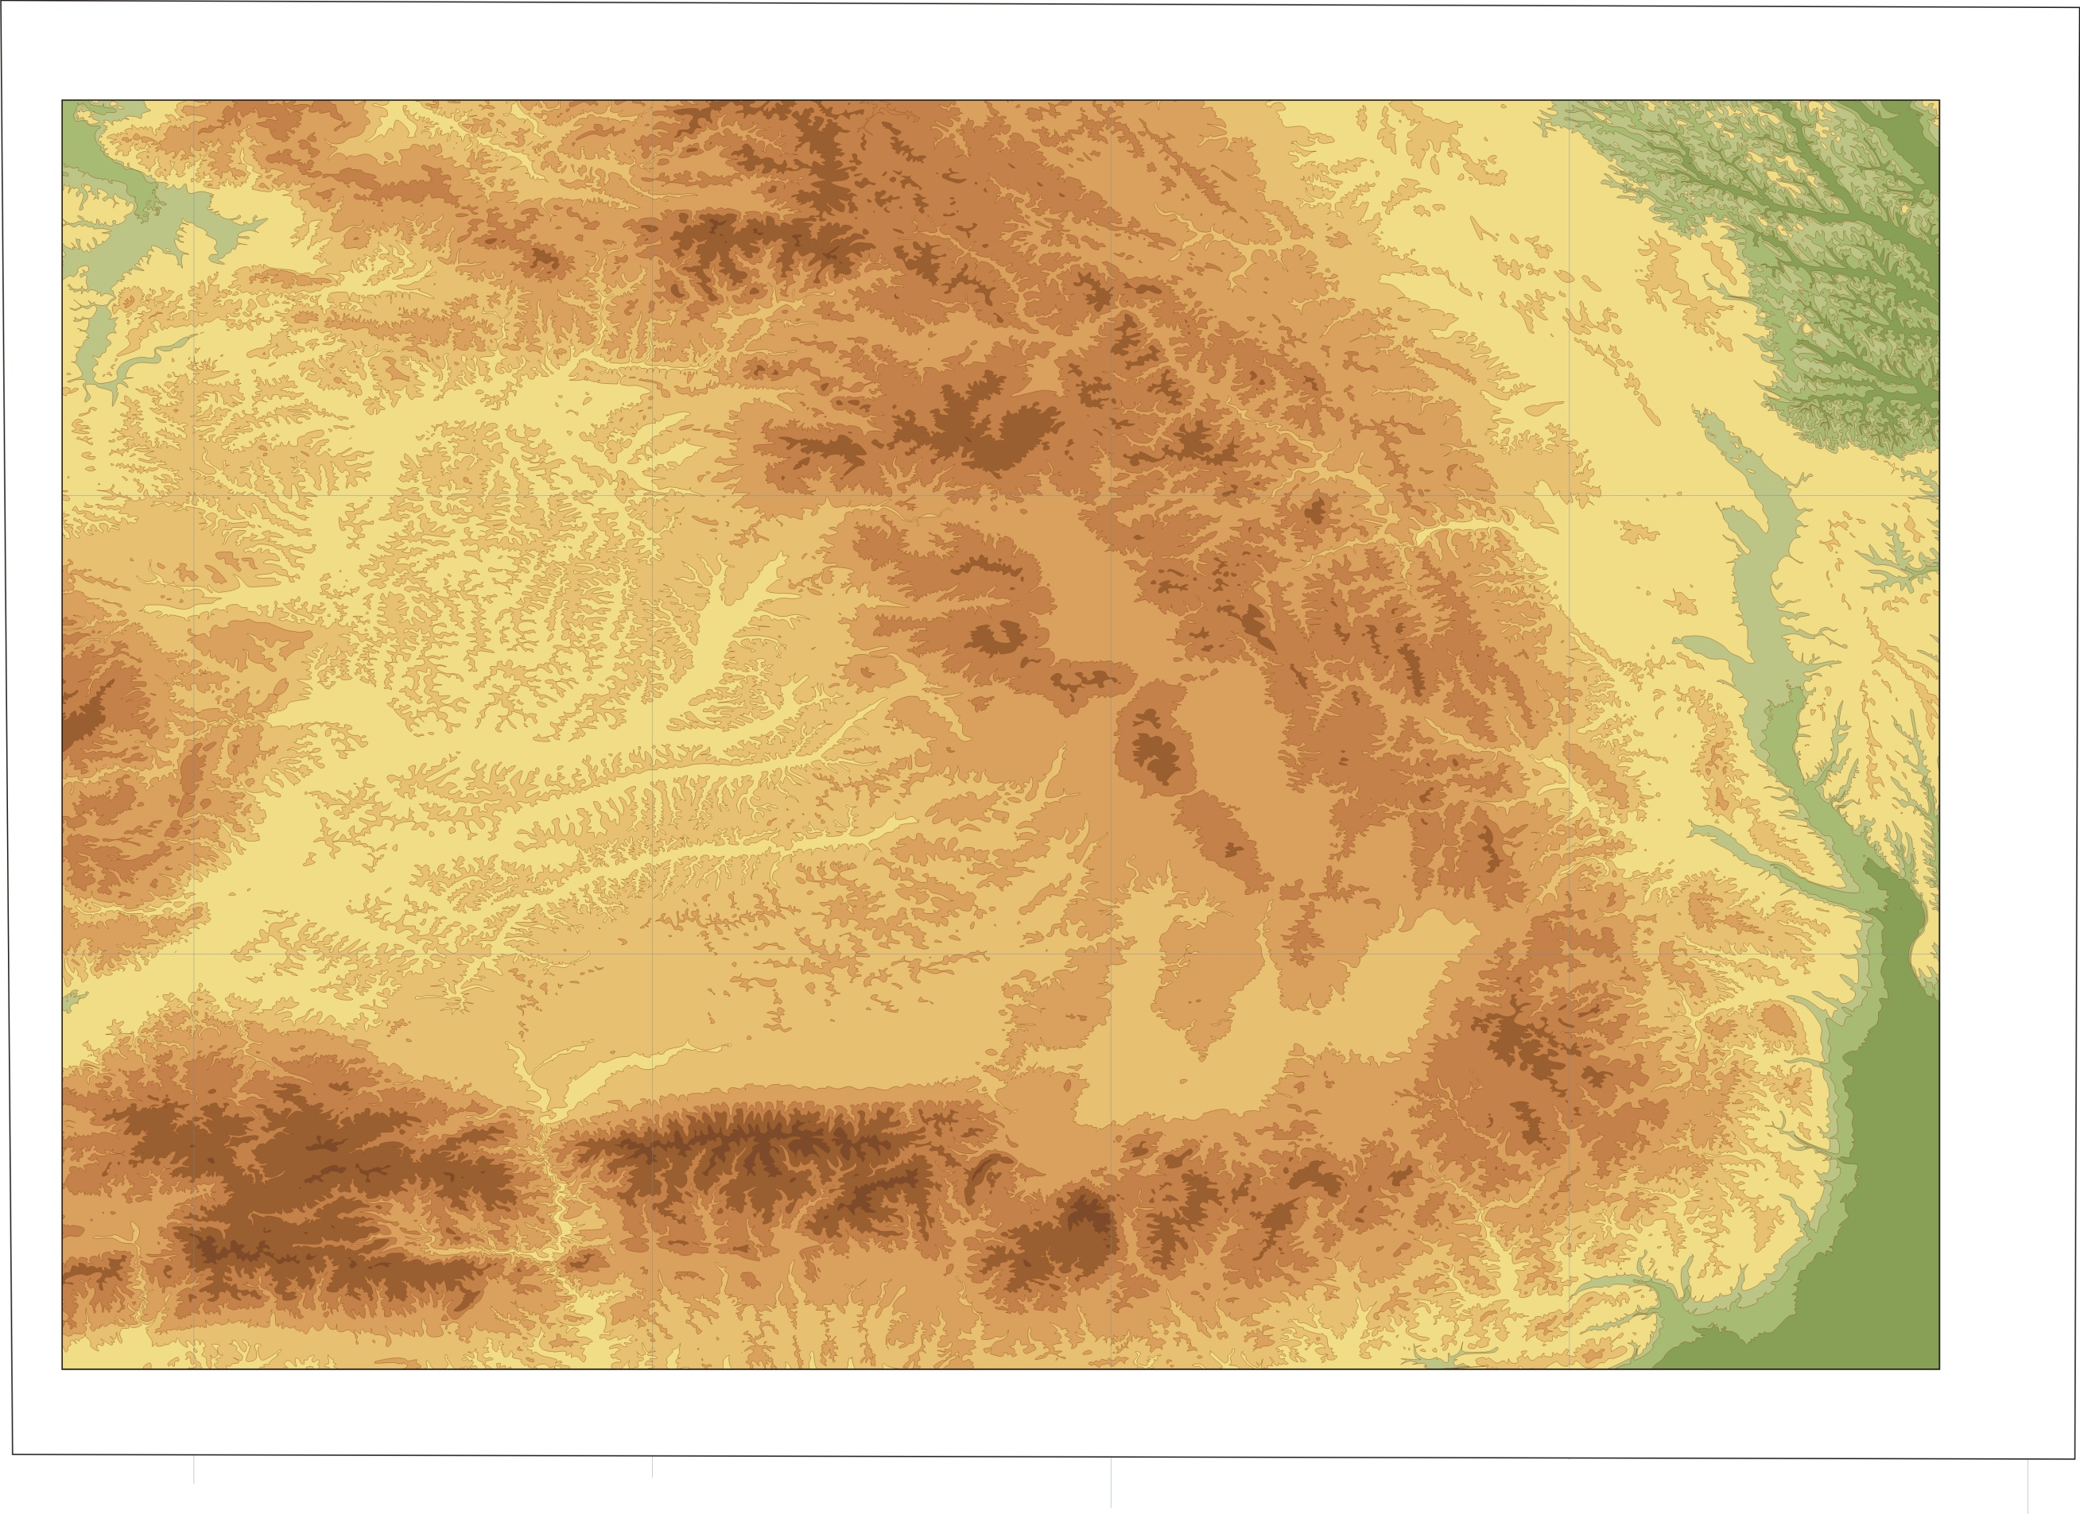

Slide 75
Polygon simplification
The algorithms are same, but we have to preserve the critical points

Slide 76
Simple border line
>1 : 2 000 000

Slide 77
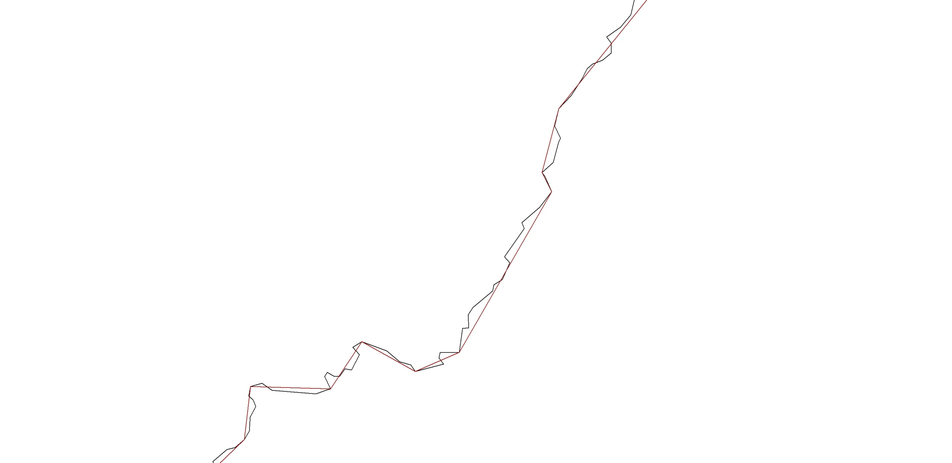
County border
Notes:
Oka: más a kezdőpont, kiküszöbölés: azonos szakaszok vizsgálata az eredeti állományban, leprogramozható

Slide 78
Original state
http://www.jasondavies.com/maps/simplify/

Slide 79
Line simplification…

Slide 80
Preserve topology, selecting the critical points

