Slide 1
Automations in cartographic generalization
3. lesson
Line smoothing and the Generalization toolset in ARCGIS

Slide 2
Smoothing

Slide 3
Smoothing
Notes:
LANG algorithm visualization: http://www.geogra.uah.es/patxi/gisweb/LGmodule/LGSelect.htm

Slide 4
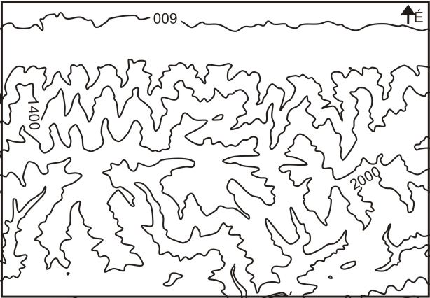
Smoothing

Slide 5
Smoothing algorithms

Slide 6
McMaster Sliding averaging, McMaster Distance Weighting
Sliding averaging: (Slide, look ahead)
A = (P_{i-2} + P_{i-1} +P_{i} + P_{i+1}+ P_{i+2} )/5
Slide: NewPi = Abs(A-Pi)/2 + P_{i}
Distance weighting: (Slide, look ahead)
the weight is the reciprocal of the distance from the point to the currently smoothed point. The parameter slide is used for linear interpolation between the original position of the point and newly computed position where value 0 means the original position.

Slide 7
McMaster Sliding averaging, McMaster Distance Weighting

Slide 8
Boyle’s forward-looking algorithm

Slide 9
Boyle’s forward-looking algorithm
The position of each point depends on the position of the previous points and the point look_ahead ahead.
(Previous example: look ahead=7)

Slide 10
Chaikin’s algorithm

Slide 11
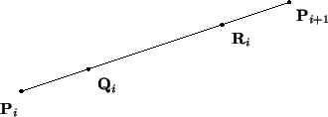
Chaikin
http://graphics.cs.ucdavis.edu/education/CAGDNotes/Chaikins-Algorithm/Chaikins-Algorithm.html

Slide 12
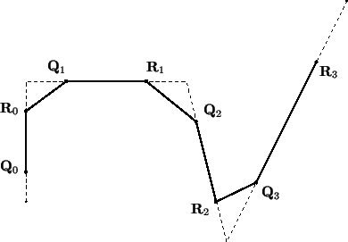
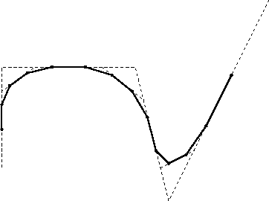
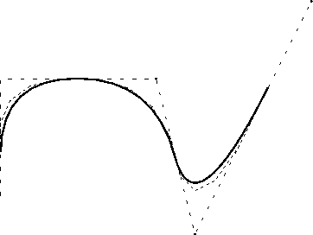
Chaikin
B-Spline

Slide 13
Snakes-algorithm

Slide 14
Snakes
Internal energy desribes the characteristics of the line
External energy helps to smooth the line and decrease the details

Slide 15
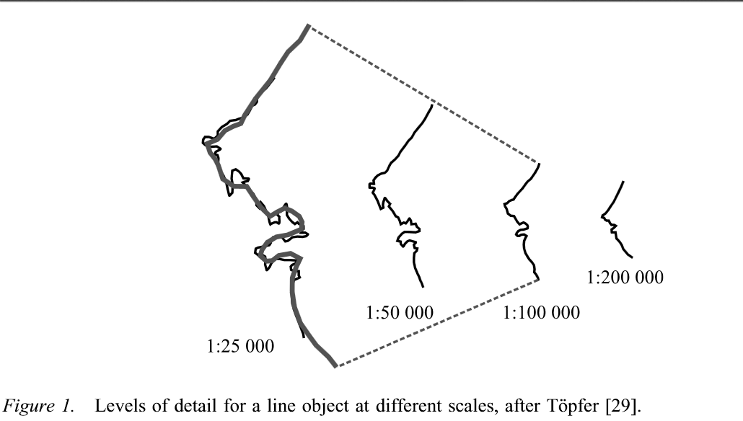
Snakes
Parameters: Alpha→elasticity and Beta→stiftness
Other usage: Digital signal processing

Slide 16
Hermite spline interpolation/Bezier curves
Replace the broken lines with real curve
Both are parametric curves
Mathematical basis: Bernstein polynomials
Pierre Bezier: 1962 used them for design automobile bodies at Renault.

Slide 17
Bezier curve
Linear „curve”
Quadratic curve: →Parabolic segment
Cubic curve:
Degree elevation is possible

Slide 18
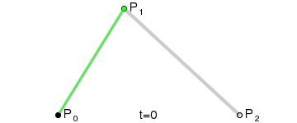
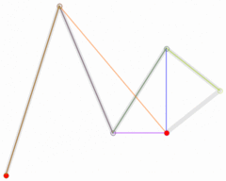
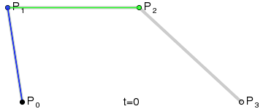
Bezier curves

Slide 19
Bezier curves…

Slide 20
ArcGIS smoothing
Smoothing line or polygon
Bezier interpolation and PAEK (Polynomial Approximation with Exponential Kernel) ~ Chaiken
Official ArcGIS Documentation in the Internet
http://resources.arcgis.com/EN/HELP/MAIN/10.1/index.html#//016w0000004v000000

Slide 21
Declaring the scale
1 : 150 000

Slide 22
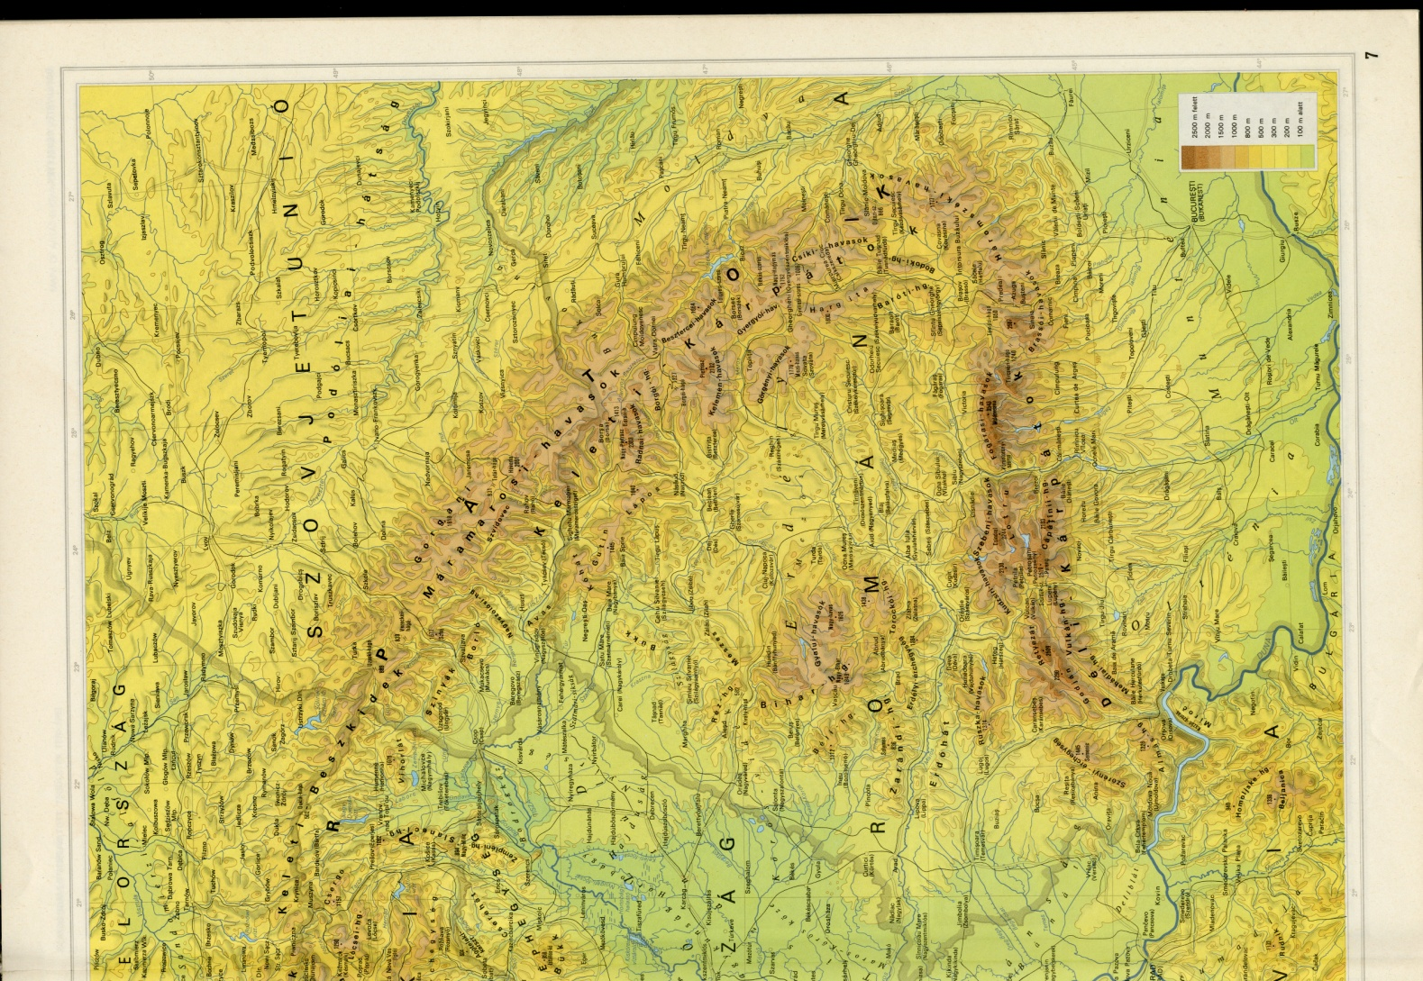
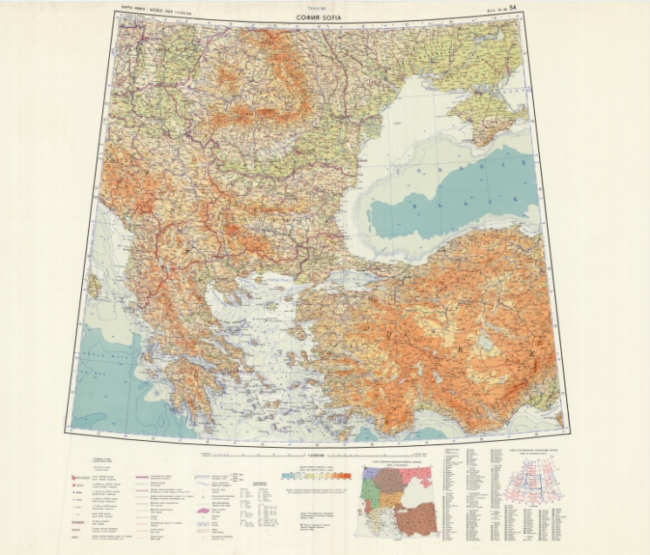
Comparing with maps
Atlas Mira 1 : 1 250 000
Hungarian National Atlas 1989
1 : 2 000 000
World Map Series
1 : 2 500 000

Slide 23
Degree of generalization

Slide 24
Continous generalization?
Different degree of generalization for every scale.
Questions:
Is it existing?
Is it necessary?

