Slide 1
Automations in cartographic generalization
4. lesson
Point generalization, digital elevation models

Slide 2
Point simplification
Set of points=point cluster

Slide 3
Point’s types
Originally represented by a point symbol:
well, fountain, small building, spot height
Features represented by areal symbols on the source map, but will be represented as a point in the target scale
Lakes, ponds, airport
Notes:
Two types of spatial features can be regarded as a point set

Slide 4
Aggregation of a set of point features
Point categorization into groups
Spatial clustering is putting similar features into sam cluster→ Minimizing dispersion in a class.
Clustering is also used in remote sensing
K-means clustering
ISODATA

Slide 5
K-means clustering (MacQueen, 1967)
Classifying a set of N points into K clusters (group)
Determine the number of clusters (K)
Designate a point as the cluster center fo each of the K cluster.
Assign every point to the nearest cluster
Compute new centroid
Repeat 4. and 5. until the centers no longer move significantly

Slide 6
ISODATA
Iterative self-organizing data analysis technique algorithm
Determine values for standard deviation, cluster number (K), number of iteration (n)
Treat all points as being in the same cluster to compute the means C_{xy} and the standard dev.
Determine whether there is need to split the cluster. If the specified number of iteration or number of cluster is reached, stop splitting.
Splitting in the Y direction, and reclassifying the points, then splitting X direction, and reclassifying the points.
Repeat step 3 to 4.
Check each point to see whether the distance to its cluster centroid is the smallest among the distances to all centroids.

Slide 7
Representing the cluster by a single point
Methods:
Mode: A point in an area with muvh higher distribution density compared with its surroundings
Mean: The average coordinates in both X and Y coords.
Median: The point that partitions the planar space into two halves in X and two halves in Y to ensure equal numbers of points on each half in the same direction
Nearest to mean: The point closest to the mean

Slide 8
Algorithms for selective omission of a set of point features
Specially developed for selective omission of settlements.
Importance of a point features can be measured by one or more attributes. For example: population, administrative status, physical size…
Settlement-spacing ration alg.
Circle-growth alg.

Slide 9
Settlement-spacing ratio algorithm
R_{i} = c/I_{i} where c>0 (radius of the circle)
I: significance of the point, C is a constant
Draw a circle around every points, according to their significance
Selection: testing the points in order of decreasing importance. The point will be selected, only, if the circle does not contain a previously selected point.

Slide 10
Circle-growth algorithm
R_{i}=c*I_{i} (radius of the circle), where c is a constant, and the I is the importance of each points.
Draw a circle around every points, according to their importance.
Selection: if the circle contains the neighbouring point, add the the rank number to the bigger one, therefore the circle radius is grown. Repeat, until the most important circles remain.

Slide 11
Algorithm for structural simplification of a set of point features
To simplify the structure of a set of point features for representation at a smaller scale, one needs to have a s set of parameters for the description of the point cluster. For example:
Point number, importance value, Voronoi neighbours, distribution range, distribution density, distribution modes, distribution axes.

Slide 12
Quadtree based point generalization by
Attributes
Selection
Local priorities
http://www.zora.uzh.ch/74663/1/2012_BereuterP_Bereuter_Weibel_AutoCarto2012.pdf
Notes:
http://www.zora.uzh.ch/74663/1/2012_BereuterP_Bereuter_Weibel_AutoCarto2012.pdf

Slide 13
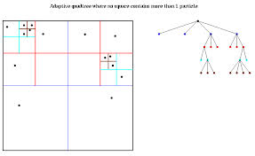
What is quadtree?
The quadtree is a well known spatial tree data structure and a generic term for a family of tessellations in which every node has four children (Samet, 1989).

Slide 14
Point selection in quadtrees
Random selection:
Insert the quadtree into the 2D pointcloud
Select a point randomly from all children in the current quadnode
If the results are used for further zooming, it is recommended to store the results based on previous LODs (level of detail)
In the second step, a quadtree-based generalization algorithm returns for each quadnode the generalized results at the desired LOD.
The LOD is mapped to the tree depth (and the LOD can be further related to the map scale).

Slide 15
Value-based selection, Centrality-based

Slide 16
Midpoint, Cluster-based, Co-location

Slide 17
On the fly generalization
„Real-time” generalization
It needs fast algorithms!

Slide 18
Raster type data
Digital elevation models

Slide 19
Elevation data
TIN model: a vector-based representation of the physical land surface or sea bottom, made up of irregularly distributed nodes and lines with three-dimensional coordinates (x, y, and z) that are arranged in a network of nonoverlapping triangles.
TIN is typically based on a Delaunay triangulation
http://en.wikipedia.org/wiki/Delaunay_triangulation
GRID model: can be represented as a raster (a grid of squares, also known as a heightmap when representing elevation

Slide 20
TIN

Slide 21
GRID

Slide 22
GRID model → DEM
Digital Elevation Model (DEM): Common term for XYZ models.
Digital Surface Model (DSM): includes all objects ( the buildings, forests…)
Digital Terrain Model (DTM): Earth physical surface (bare ground without any object )

Slide 23
Global or semi-global DEM models
GTOPO30 (1996) https://lta.cr.usgs.gov/GTOPO30
is a digital elevation model for the whole world (landmass), developed by USGS. It has a 30-arc second resolution (approximately 1 km), and is split into 33 tiles stored in the USGS DEM file format.

Slide 24
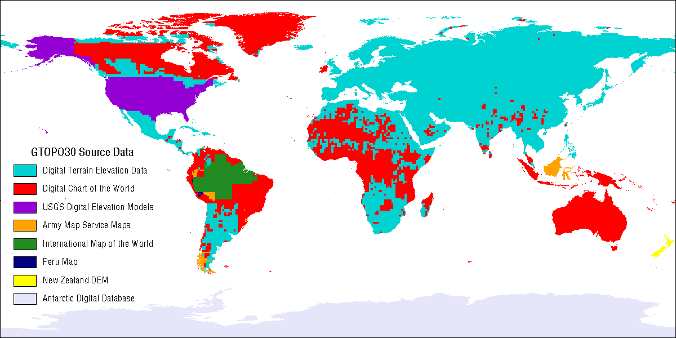
GTOPO30 data sources

Slide 25
SRTM Shuttle Radar Topographic Mission
SRTM90 (2000)
The Shuttle Radar Topography Mission (SRTM) is a joint project between the National Geospatial-Intelligence Agency (NGA) and the National Aeronautics and Space Administration (NASA). The objective of this project is to produce digital topographic data for 80% of the Earth's land surface (all land areas between 60° north and 56° south latitude), with data points located every 1-arc second (approximately 30 meters) on a latitude/longitude grid. The absolute vertical accuracy of the elevation data will be 16 meters (at 90% confidence).

Slide 26
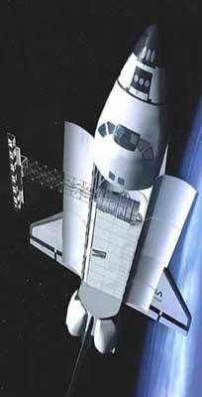
SRTM
LAUNCH DATE: Feb. 11th 2000
DURATION: 11 days SPACE SHUTTLE: Endeavour

Slide 27
SRTM

Slide 28
Available SRTM models
SRTM90→ 3 arc seonds ~ 90 m
SRTM30→ 30 arc seconds ~ 1km
For the USA: 1 arc seconds ~ 30 m
http://www.cgiar-csi.org/data/srtm-90m-digital-elevation-database-v4-1
News in September 2014: 1 arc seconds model for the „whole” world (80%) during the next year.

Slide 29
ACE2
http://tethys.eaprs.cse.dmu.ac.uk/ACE2/shared/overview
3, 9, 30 second and 5 minute dataset
The new ACE2 Dataset has been created by synergystically merging the SRTM dataset with Satellite Radar Altimetry within the region bounded by ±60N. Over the areas lying outside the SRTMs latitude limits other sources have been used such as including GLOBE and the original ACE DEM, together with new matrices derived from reprocessing the ERS1 Geodetic Mission dataset with an enhanced retracking system, and the inclusion of data from other satellites. The main altimetry dataset used in the generation of the dataset was the ERS-1 Geodetic mission; which due to its small across track spacing presents a uniquely dense spatial distribution of tracks of Radar Altimeter data over land surfaces. Data from ERS-2 and EnviSat Ku-band are included where appropriate. All of the altimeter data have been reprocessed using the Berry Expert System to retrack the waveforms.

Slide 30
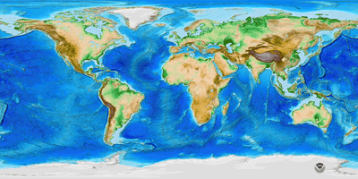
ETOPO1
Global model: 1 arc minutes.
Bathymetry!
http://www.ngdc.noaa.gov/mgg/global/global.html
ETOPO1 Ice Surface: Grid of Earth's surface depicting the top of the Antarctic and Greenland ice sheets.
ETOPO1 Bedrock: Grid of Earth's surface depicting the bedrock underneath the ice sheets.

Slide 31
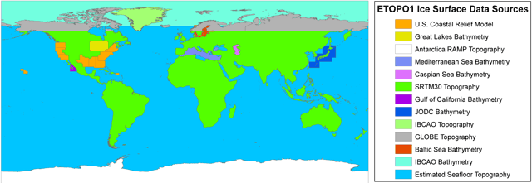
Etopo 1 data sources, Ice Surface

Slide 32
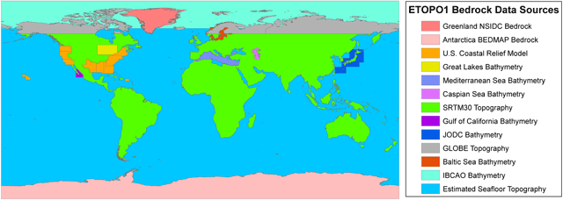
Etopo1 data soruces, Bedrock

Slide 33
ASTER GDEM (v2) 2011.
The Ministry of Economy, Trade, and Industry (METI) of Japan and the United States National Aeronautics and Space Administration (NASA) jointly announced the release of the Advanced Spaceborne Thermal Emission and Reflection Radiometer (ASTER) Global Digital Elevation Model Version 2 (GDEM V2) on October 17, 2011.
The first version of the ASTER GDEM, released in June 2009, was generated using stereo-pair images collected by the ASTER instrument onboard Terra. ASTER GDEM coverage spans from 83 degrees north latitude to 83 degrees south, encompassing 99 percent of Earth's landmass.
http://gdem.ersdac.jspacesystems.or.jp/

Slide 34
In Aster GDEM, you can see the vegetation

Slide 35
EU-DEM
The EU-DEM is a 3D raster dataset with elevations captured at 1 arc second postings (2.78E-4 degrees) or about every 30 metre.
Only EUROPE
Merged SRTM and ASTER GDEM
http://land.copernicus.eu/in-situ/eu-dem

Slide 36
Working with DEMs

Slide 37
Problem
If we would like to make a hypsometric map from ETOPO1, and we color the lands and the oceans, we will find some continent areas (The Netherlands), where there are land under the sea level. In the model, it looks like it is a part of ocean. But in fact it is a continental area.
How can we make a right representation of the land?

Slide 38
Border lines and ETOPO1

Slide 39
Create hypsometry

Slide 40
Check the areas under 0 meter

Slide 41
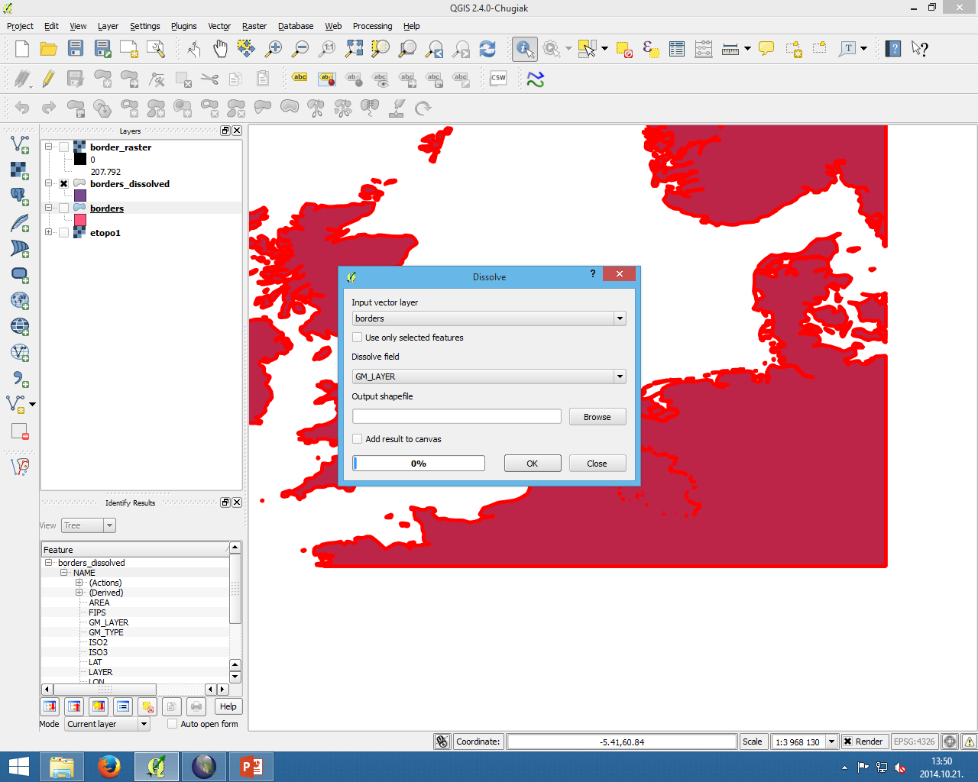
Dissolve the area borders to a polygon (landmass)

Slide 42
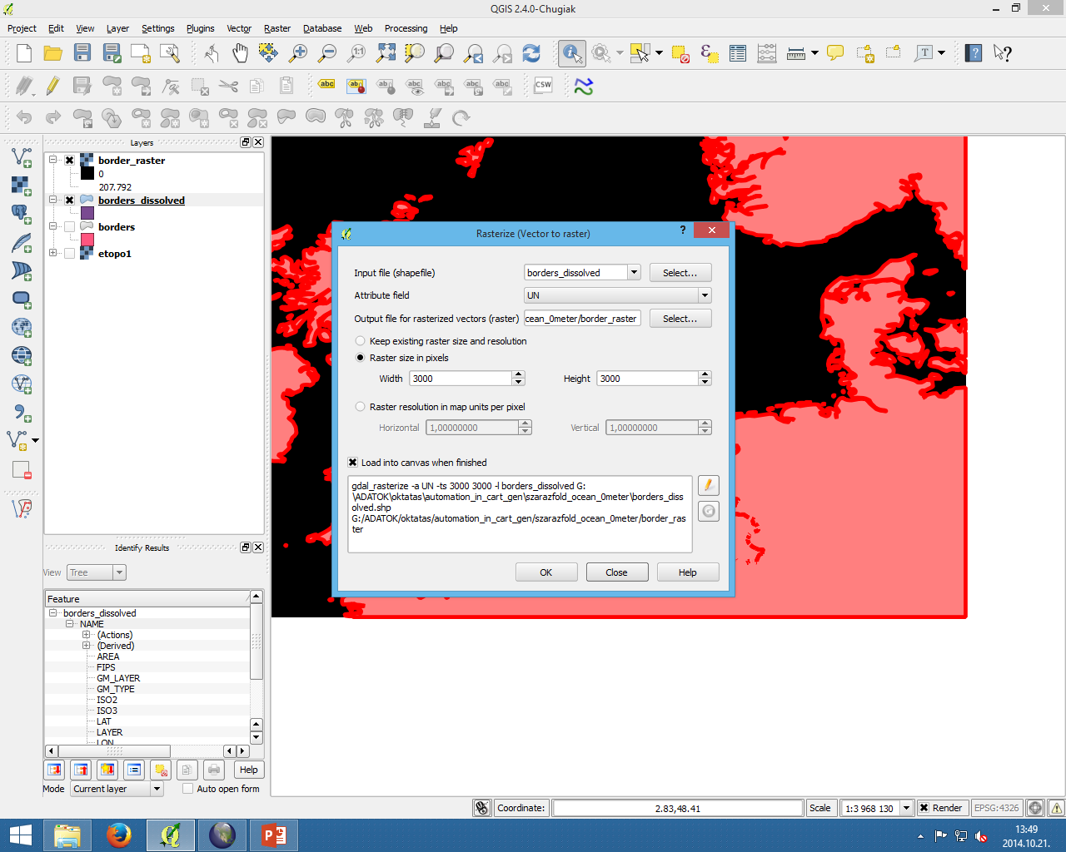
Rasterize (Raster→Rasterize)

Slide 43
Change the image pixel values
Raster→Raster Calculator
Borders_raster/borders_raster layer
=> The pixel values are No data(oceans) and 1 (lands).

Slide 45
Almost done…

Slide 46
Set the hypsometry

Slide 47
Check the new raster and vector layer

Slide 48
Solution in QGIS HOMEWORK 3.
Open a vector layer of border lines of countries
Dissolve the country borders in vector menu
Raster→Conversion→Rasterize (Vector to raster) (RBorder)
Open raster calculator→Rborder/Rborder (create no data values for oceans, 1 for lands)
Raster Calculator ETOPO1/Rborder
Order the layers in Layer handler, set the hypsometry at Properties
Export the new elevation map.

Slide 49
DEM generalization by image processing
http://mapw.elte.hu/elek/cikkek/352_agen_elek.pdf

Slide 50
Digital image processing
Fourier transformation
But, how it works in practice?
You have a matrices, which size is (2*k+1)X(2*k+1)
This kernel moves through the image→Filtering
Notes:
Odd =páratlan

Slide 52
How it works
Get the values from the image.
Calculate the mid pixel new value.
Put the new value back only to the mid pixel.
Repeat it.

Slide 53
How can we calculate the new value
Get the elevations from the image. Calculate the average.
We have a pre-defined kernel

Slide 54
Edges…

Slide 55
Global Mapper v. 13. image filtering
Box Average
Box Minimum
Box Maximum

Slide 56
Original, Box Average 3x3, 5x5, 9x9

Slide 57
The resolution of the new model is smaller, you can use them smaller size as the original one

Slide 58
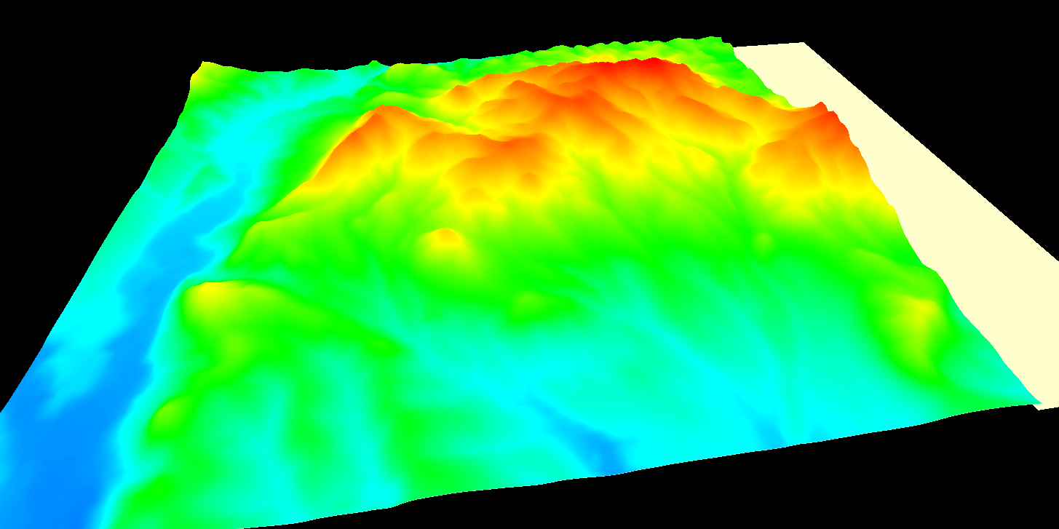
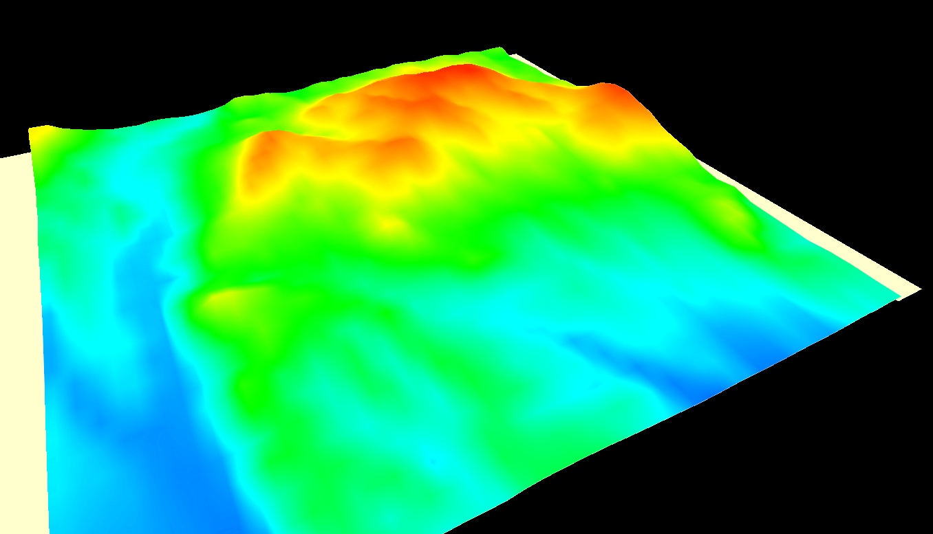
3D view of the smoothed image by 3x3 and 9x9 kernel

Slide 59
Comparison of elevation changes

Slide 60
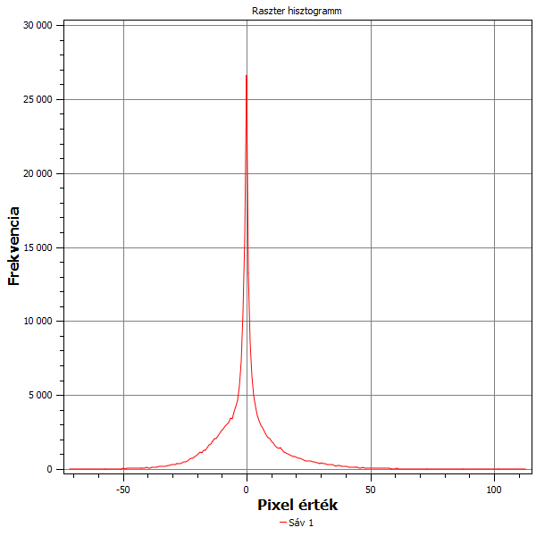
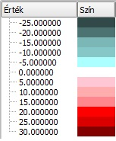
The changes of elevations compared the filtered SRTM and the original SRTM data
Histogram of changes (The most changes are between +/- 25 meter)
Blue means the surface became lower, the red shows the higher areas

Slide 61
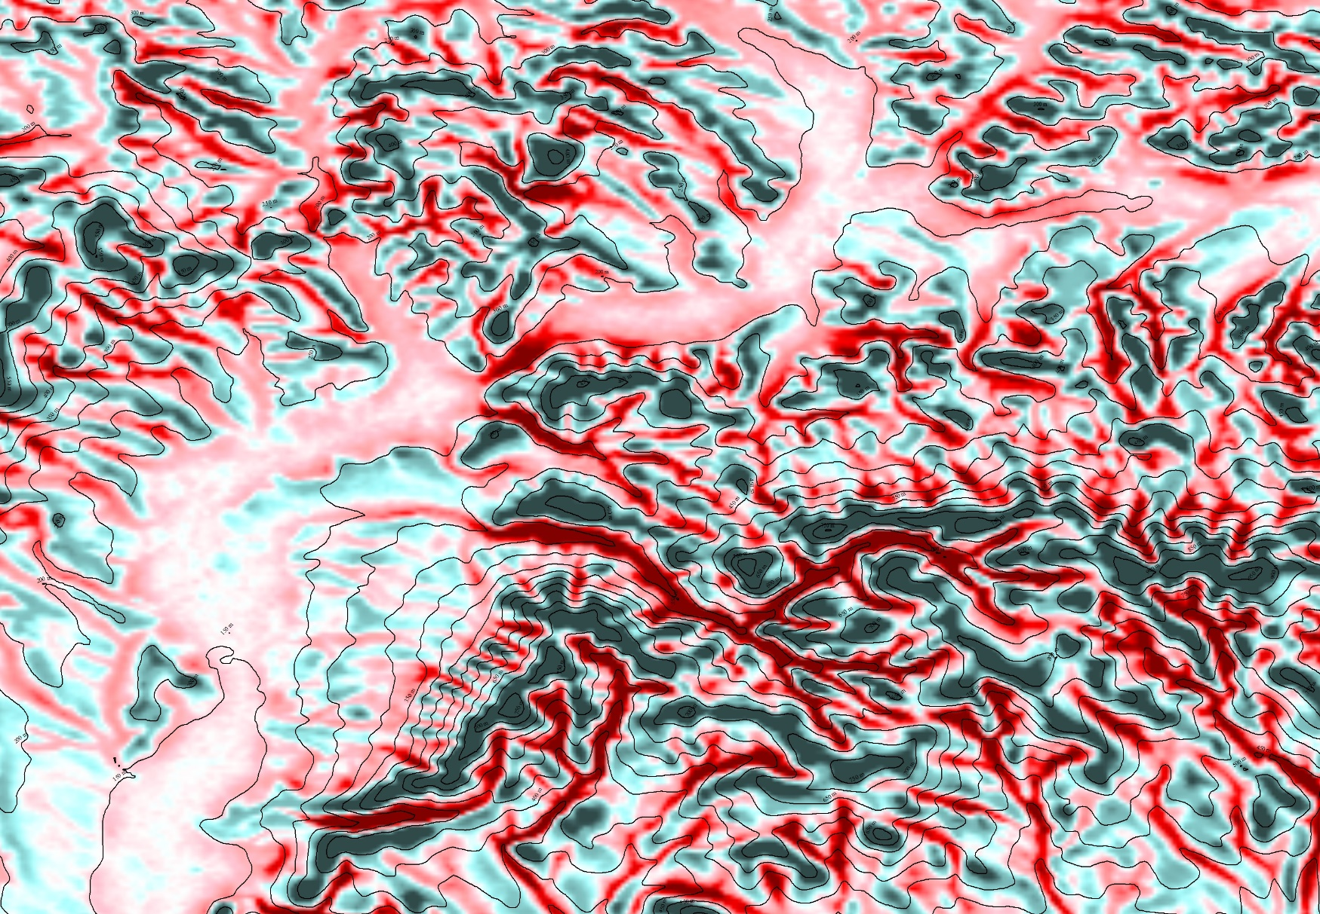
The bigger changes happened at the tight valleys and at the ridges

Slide 62
Location of sample area
https://maps.google.com/maps/ms?ie=UTF8&oe=UTF8&msa=0&msid=115078976295020261494.000471decb27a3a990fd3&dg=feature
→Mátra mountain

