Slide 1
Automations in cartographic generalization
4. lesson
Raster data generalization

Slide 2
Automations in thematic cartography
Base map
Thematic content
Data generalization in thematic cartography depends on the thematic method.

Slide 3
Proportional symbols
Take the minimum and maximum data value, and calculate the min. and max. size of the symbol. You can work with normal, exponential or logarithmic scale.
You can make different size for every value or you can set categories

Slide 4
Dot distribution map
Dot distribution (density) maps: a dot symbol to show the presence of a feature or phenomenon.
Types:
One-to-one: one dot one piece: It is linked to a coordinate pair
One-to-many: one dot represents more pieces. It is not linked to a coordinate pair.

Slide 5
John Snow's cholera map
Display of discrete data in the form of points in a map can provide convincing evidence related to medical geography. During the mid-1850s, cholera was a major concern. When a large outbreak occurred in London in 1854, Dr. John Snow created a dot distribution map that settled a debate between two schools of thought: that cholera is transmitted not through the inhalation of infected air, but through the ingestion of contaminated water or food.

Slide 6
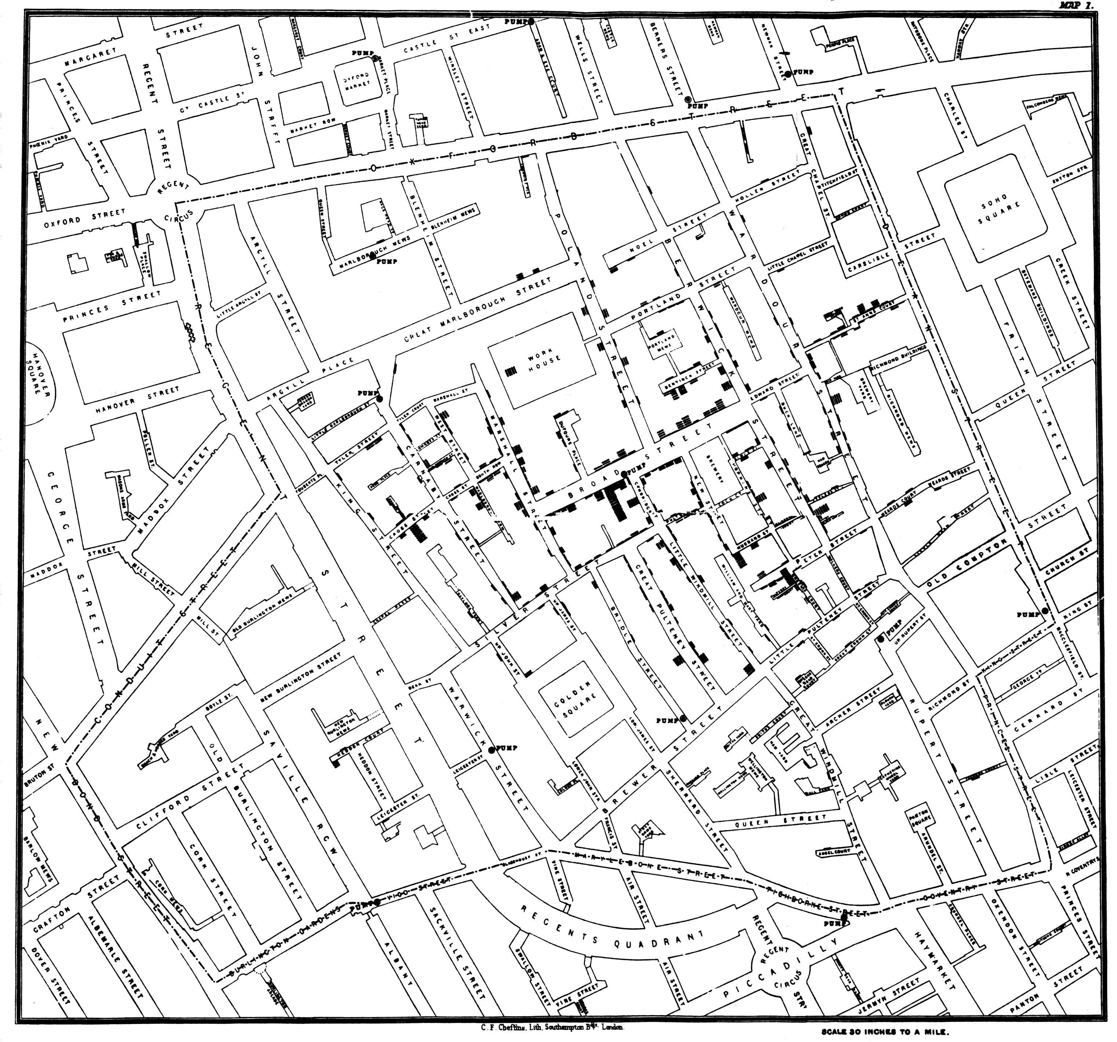
Snow’s cholera map

Slide 7
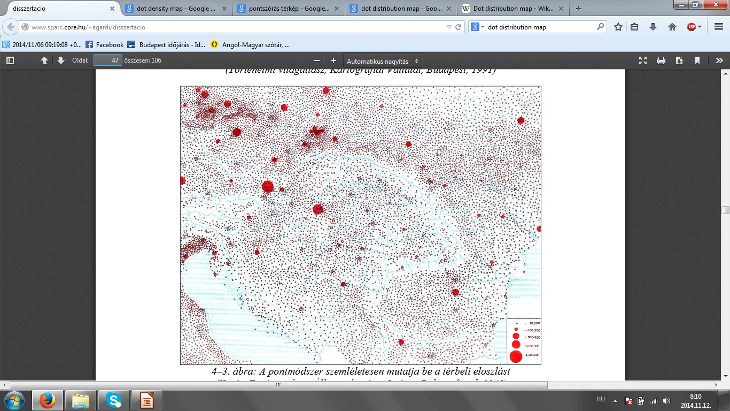
One to more dot distribution map

Slide 8
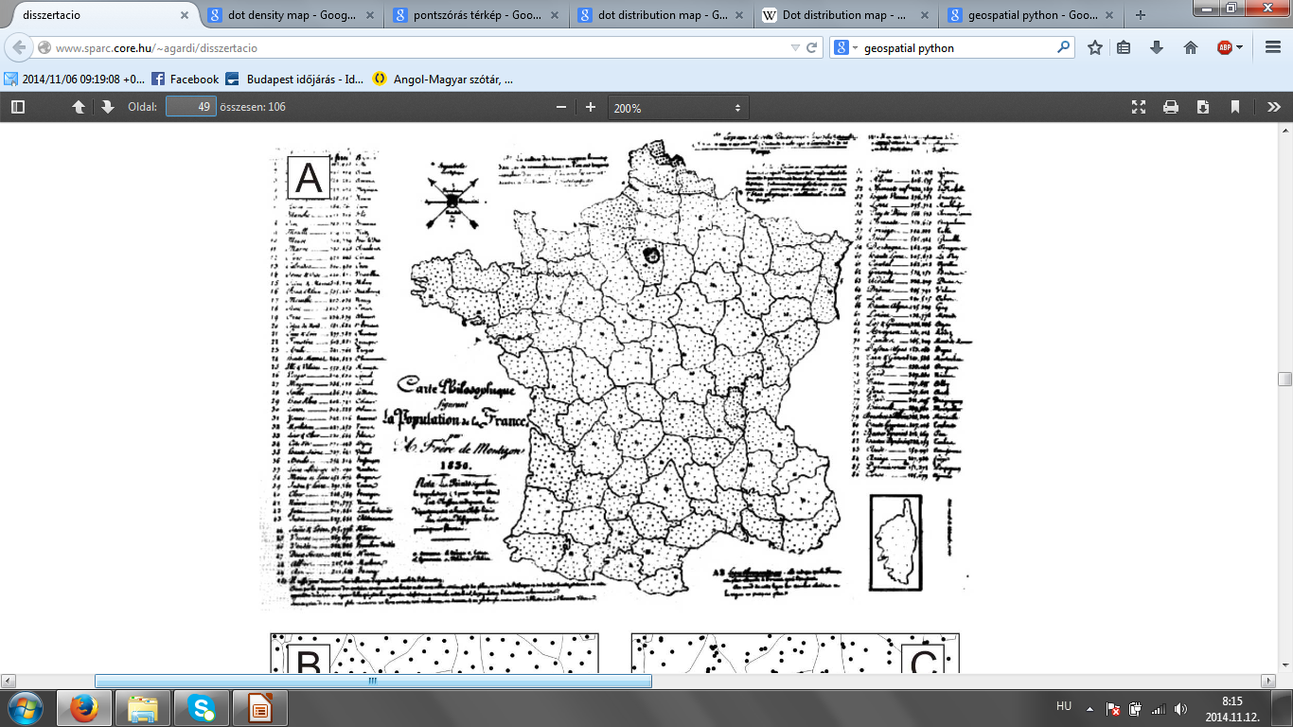
Frére de Montizon: Carte philosphique figurant la population de la France, 1830. First printed population density map

Slide 9
The number of horses in the Austro-Hungarian Monarchy

Slide 10
Today's dot distribution maps

Slide 11
How to make automations
To revise the dot distribution at one-to-many data.
Read the polygon, and calculate the value of a point.
Find the x,y min and max coordinates
Write a function which contains a spatial pattern
The number of points, what we should put into a polygon is known. According to the spatial pattern, we have to examine that the polygon contains or not contains the new point.

Slide 12
Isolines
Isolines connect points with same values.
Contours!

